Slide 1
DATACUT Film Cutting System
User Manual · Operation Training
From software download and installation to PPF template design, smart layout, and cutting output
Full-Process Operation Guide & Feature Details
Notes:
Welcome to the operation training for the DATACUT Film Cutting System. This manual will guide you from software download and installation, step by step through vehicle data filtering in the Data Center, film template editing in the Design Platform, smart layout, and the final cutting output. Please follow the demonstration step by step.

Slide 2
Learning Contents
From Beginner to Expert · Full-Process Operation Guide
01 Software Download & Installation
02 Login & Account Registration
03 Home Page Introduction
04 Home Page Notes
05 Data Center
06 Vehicle Data Filtering Process
07 Entering the Design Platform
08 Design Platform Main Interface
09 Design Workspace
10 Detailed Feature Description
11 Smart Layout & History
12 Full-Process Summary
Notes:
This training consists of 12 modules. The first 6 modules cover the software basics, including download & installation, login & registration, home page overview, and Data Center usage. The latter 6 modules focus on the core operations of the Design Platform, including interface overview, workspace, detailed description of the 21 function buttons, and advanced features such as smart layout. Please learn in order.

Slide 3
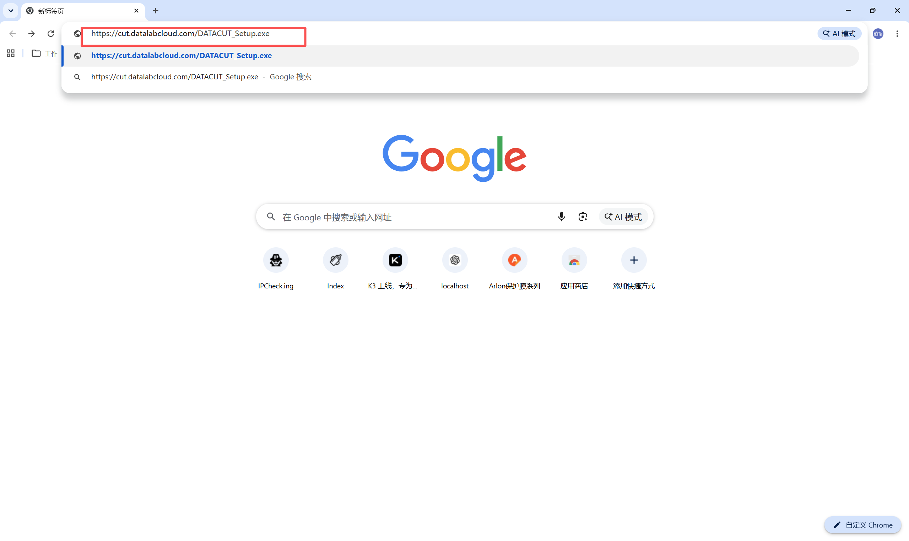
01 Software Download
Get the DATACUT Installer
Download URL:https://cut.datalabcloud.com/DATACUT_Setup.exe
Installer file:DATACUT_Setup.exe
Steps
1. Open a browser (Chrome or Edge recommended)
2. Enter the download URL in the address bar
3. The browser starts downloading the installer automatically
4. Wait for the download to finish and open the download folder
Fig: Datacut installer download page
Notes
Interface description
① Browser address bar — shows the official download URL
② Download task window — shows DATACUT_Setup.exe
Once the download is complete, proceed to installation
Ensure the network connection is stable; do not close the browser during the download
Save to a fixed location for easy installation and maintenance later
If a security warning appears, confirm the file comes from the official URL and continue
Notes:
First, let's download the software. Please open your browser and enter the official download URL in the address bar. Note that this is the only official URL — please do not download from other third-party sources to avoid security risks. After the download completes, the installer file is named DATACUT_Setup.exe. It is recommended to save it on the desktop or in a fixed download folder for easy retrieval later.

Slide 4
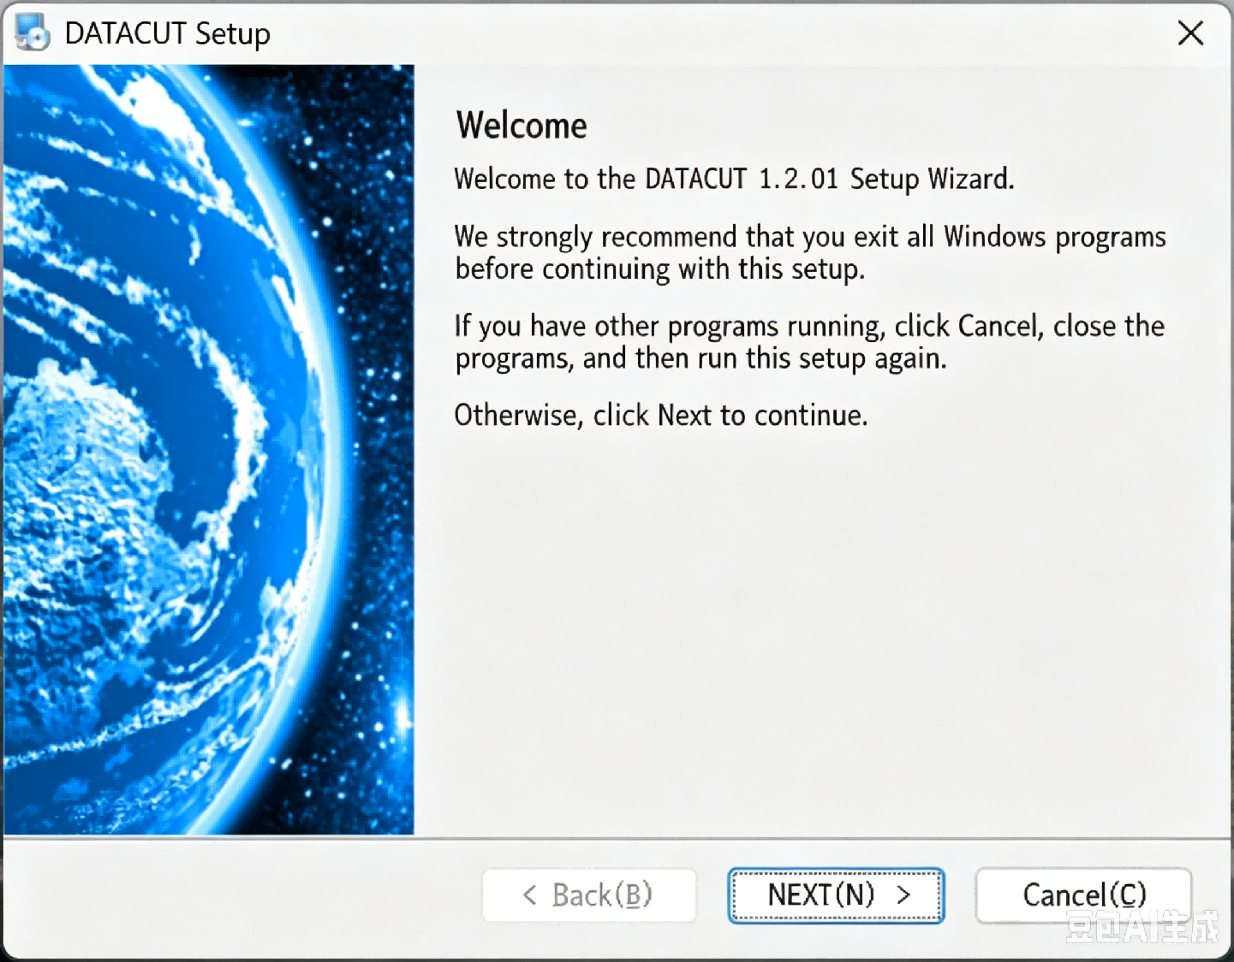
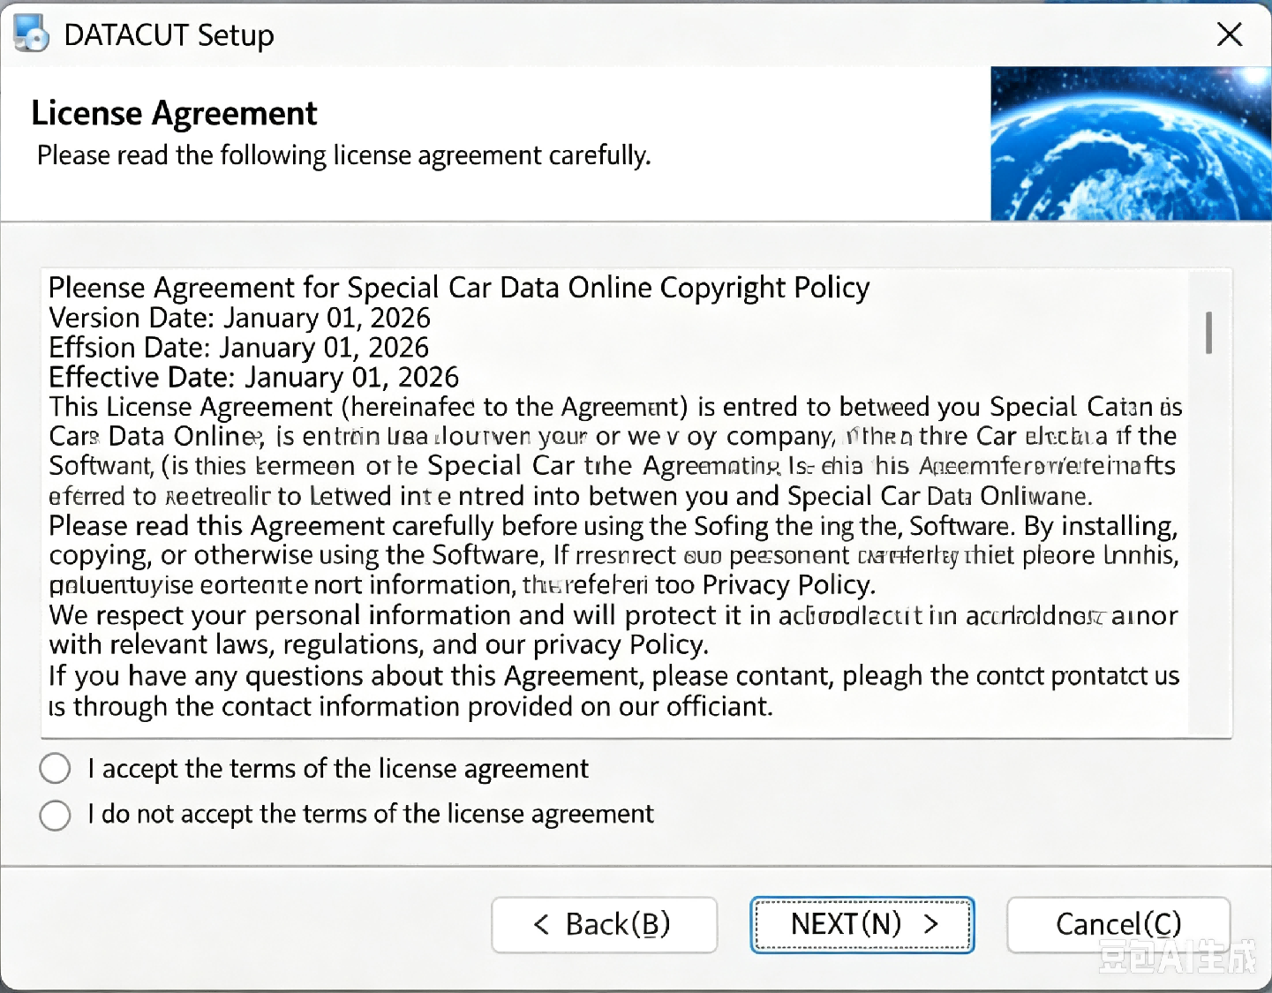
02 Software Installation
Install the DATACUT Software
After the download completes, follow these steps to install the software
1
Double-click to run the DATACUT_Setup.exe installer
2
The system launches the DATACUT installation wizard
Fig 1: Double-click to run the installer
3
Follow the wizard prompts to complete the installation (path, components, etc.)
Notes:
- Installation cannot continue unless "I accept the terms of the license agreement" is selected;
- It is recommended to read the agreement before installation;
- To cancel the installation, click "Cancel".
Fig 2: The system launches the DATACUT installation wizard
Notes:
After the download completes, locate the DATACUT_Setup.exe file and double-click to run it. The system will launch the installation wizard; just follow the prompts step by step. Note that if Windows shows a security prompt during installation, choose "Run anyway" because this is our official installer. It is recommended to use the default installation path to avoid problems that non-English paths may cause. After installation, a DATACUT shortcut will be created on the desktop.

Slide 5
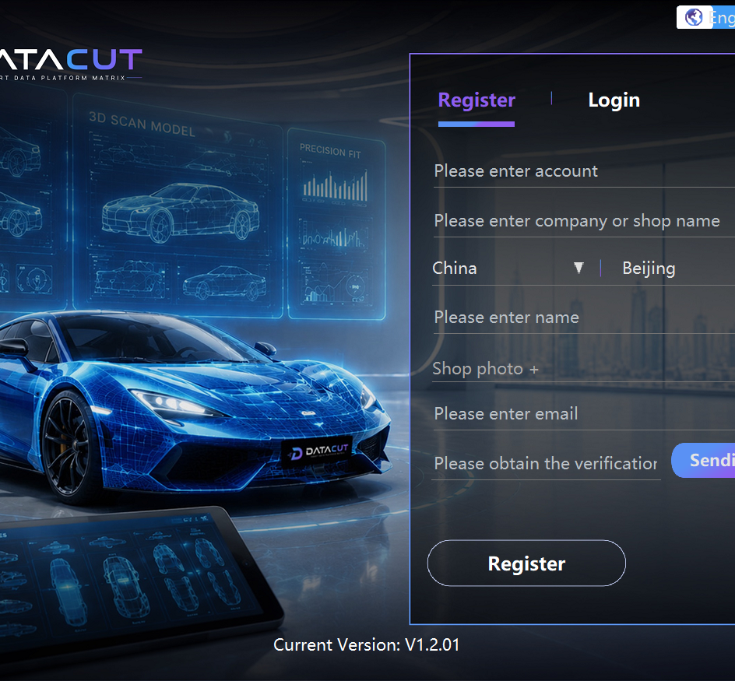
03 Login & Account Registration
Register an Account and Log In
First-time users need to register an account. Fill in the following information to complete registration
Field Name | Description
Account | Account information used for login
Company/Shop Name | Enter your company or installation shop name
Country/Region | Select the country or region of the account
Name | Enter the contact person's name
Shop Photo | Upload images related to your shop
Email | Enter a valid email to receive verification information
Verification Code | Get the verification code via email to complete verification
Register | Submit the registration information
Fig: Registration interface description
After successful registration, log in with your account and password
Notes:
After installation, the first launch of the software requires account registration. Please fill in each field as prompted, including account, company or shop name, country/region, name, shop photo, email, etc. The email is used to receive the verification code, so make sure it is entered correctly. After filling in, click the Register button to submit the registration. After successful registration, log in with your account and password to start using the software.

Slide 6
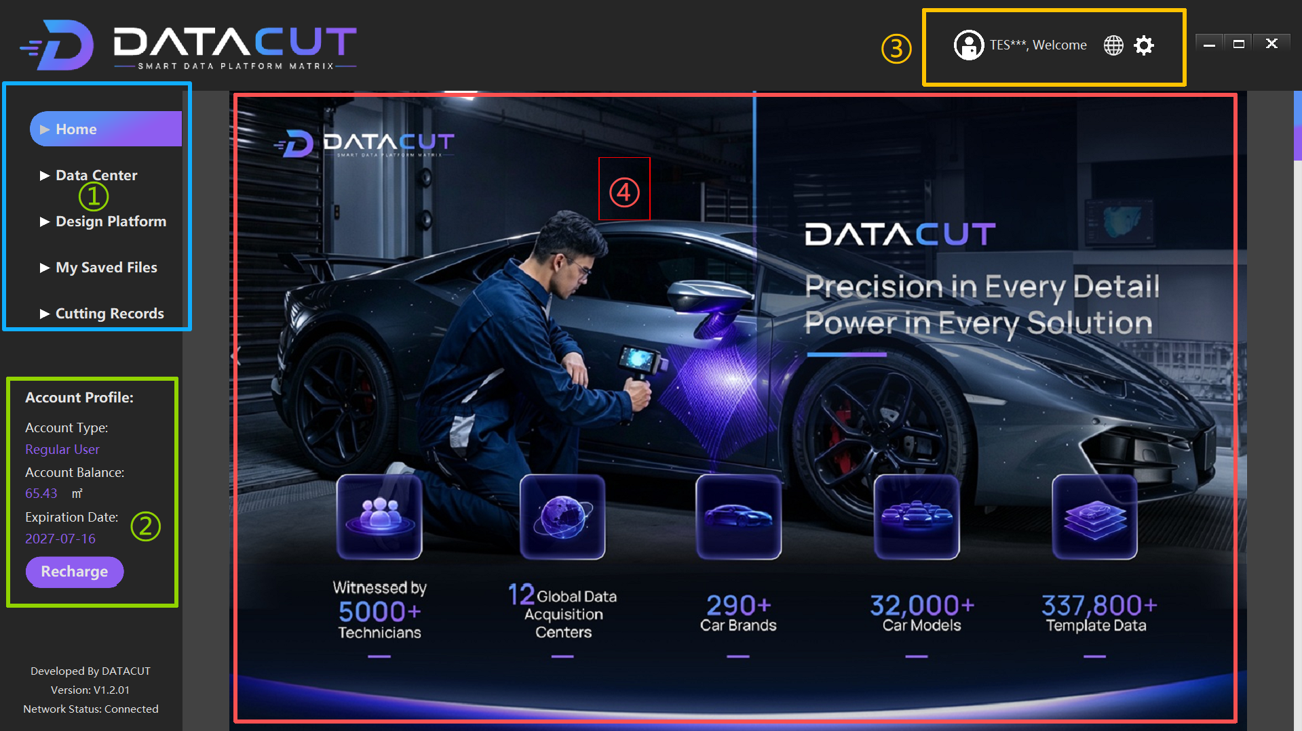
04 Home Page Introduction
Home Page Overall Layout
After successful login, the Home page opens automatically and is divided into four areas
① Left Function Navigation Bar
Entries to the five major modules such as Home / Data Center / Design Platform
② User Account Information Area (bottom left)
Account type, balance, validity period, top-up entry
③ Top Status Bar
User avatar, language switch, system settings, window controls
④ Home Display Area (center)
Brand introduction, application scenarios, global data resources, template scale
Notes:
After successful login, the system automatically enters the Home page. This interface is mainly divided into four areas: on the left is the function navigation bar with five main module entries; at the bottom left is the account information area where you can check the account type, balance, and validity period; at the top is the status bar containing the user avatar, language switch, and system settings; in the center is the display area showing the brand introduction and data resource information. Getting familiar with these four areas is the basis for using the software.

Slide 7
04 Home Page Introduction · Area Details
Left Function Navigation Bar
Top Status Bar
Menu Name | Function Description
Home | Software home page: platform introduction and basic information
Data Center | Data Center: access vehicle and template data resources
Design Platform | Design Platform: film template design and related operations
My Saved Files | My Saved Files: view saved data files
Cutting Records | Cutting Records: view historical cutting task records
User avatar/account — Shows the current logged-in user
Account information — Current logged-in account (e.g. TES***)
Welcome — Welcome message
Language button — Switch the software display language
Settings button — Enter system settings
Window controls — Minimize, maximize, close
User Account Information Area
Home Display Area
Account Profile — Account information
Account Type — Account type
Account Balance — Account balance/available quota
Expiration Date — Account validity period
Recharge — Top-up entry
The central area of the software displays DATACUT platform introduction information:
• DATACUT brand introduction
• Paint Protection Film (PPF) application scenarios
• Global data resource information
• Vehicle template database scale
Tip: Different account permissions may affect available features. Before use, please confirm the account is in a valid state
Notes:
Let's look at each area of the home page in detail. The left navigation bar has five menus: Home, Data Center, Design Platform, My Saved Files, and Cutting Records. These five modules make up the core functions of the software. At the bottom left is the account information, where you can check the account type, balance, and validity period; if the balance is insufficient or expired, top up in time. The top status bar allows language switching and access to settings. The central area shows the platform introduction and data resources.

Slide 8
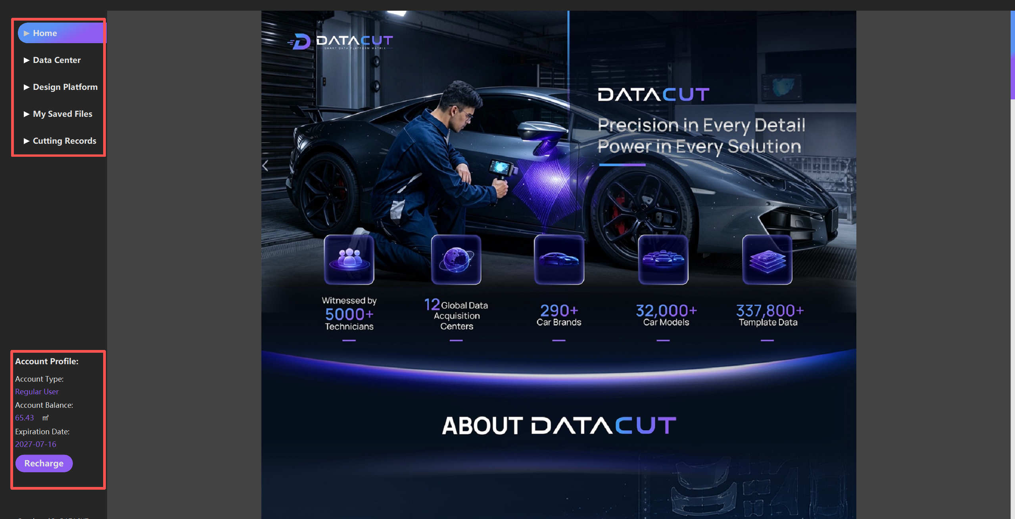
05 Home Page Notes
Operation Flow After Login
Important Notes
After successful login, follow these steps to start
1. Before using the software, confirm the account is valid
2. Keep the network connected
3. Different account permissions may affect available features
4. If the account balance is insufficient or expired, handle it promptly
1
The system automatically enters the Home page
After successful login, it redirects to the home page by default
2
Check whether the account status is normal
Confirm that the balance, validity period, and permissions are correct
3
Choose a function menu on the left as needed
Enter the Data Center or Design Platform
4
Enter the corresponding module to operate
Vehicle data query, film template design, or cutting
Notes:
After successful login, the system automatically enters the Home page. Then follow these four steps: Step 1, the system automatically enters the home page; Step 2, check the account status at the bottom left and confirm the balance and validity period are normal; Step 3, choose a function menu on the left as needed — usually we first enter the Data Center to look up vehicle data; Step 4, enter the corresponding module for vehicle data query, film template design, or cutting. A special reminder: before use, always confirm the account is valid and the network connection is normal.

Slide 9
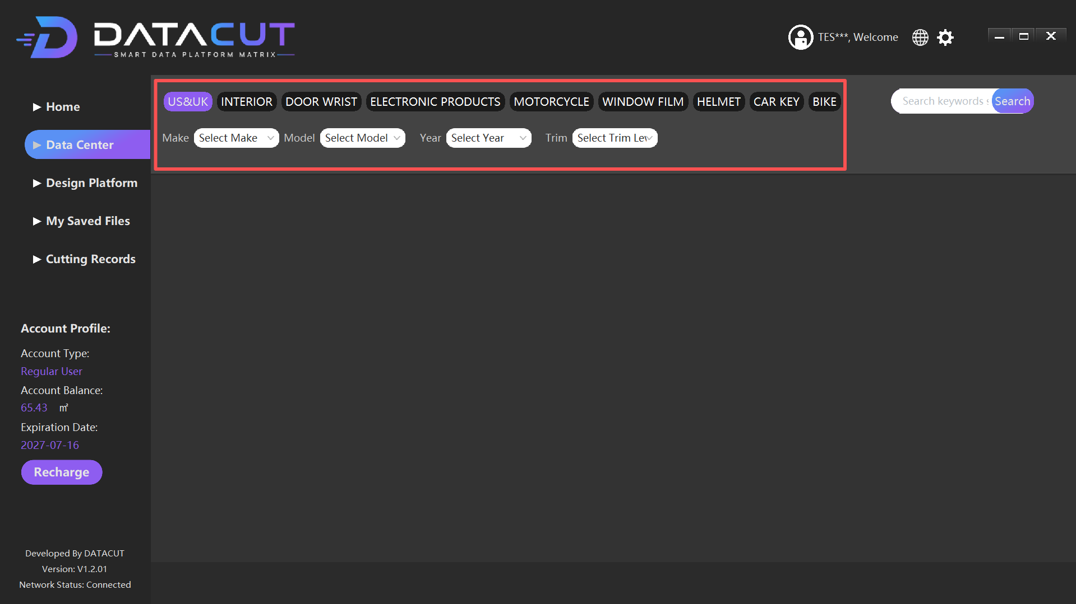
06 Data Center
Core Data Resource Management Module
Quickly find data of different types of cars and related products,
locating the target data through four-level filtering by brand, model, year, and trim
Top Data Category Entries
US&UK
INTERIOR
DOOR WRIST
ELECTRONIC
MOTORCYCLE
WINDOW FILM
HELMET
CAR KEY / BIKE
Filter Function Area
Search Keywords — Quick keyword search for models or data
Make — Select the car brand
Model — Select the specific model
Year — Select the vehicle year
Trim Level — Select the model trim
Data Display Area — Shows the corresponding vehicle template data
Notes:
The Data Center is the core data resource management module of the software. The top has multiple data category entries, including US/UK market vehicles, interiors, door armrests, electronic products, motorcycles, window films, helmets, car keys, bicycles, etc. You can choose the corresponding data type according to your actual processing needs. Below is the filter area: locate the target vehicle data through keyword search and the five-level filtering of brand, model, year, and trim. On the right is the data display area showing the corresponding vehicle template data.

Slide 10
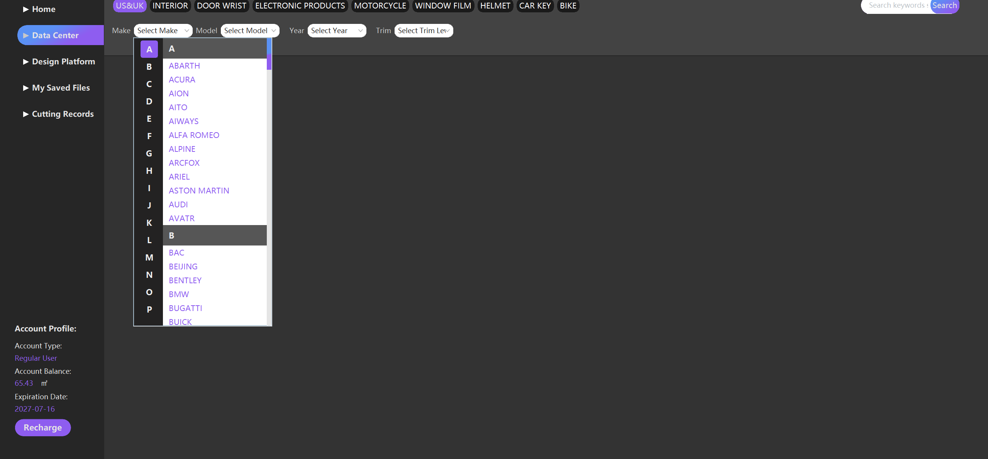
07 Vehicle Data Filtering Process
Four-Level Filtering: Brand → Model → Year → Trim
Step 1: Select the Brand (Make)
Step 2: Select the Model
Step 3: Select the Year
Step 4: Trim
Select the vehicle manufacturer brand
Example:
BMW / Mercedes-Benz
Toyota / Tesla
After selection, the corresponding brand's model data is loaded
Select the specific model based on the brand
Example:
Brand: BMW
Model: 7 SERIES
The system automatically matches the model database
Select the vehicle production year
Example: 2026
The system matches, based on the year,
the corresponding model version data
Data may differ between years
Select the specific vehicle trim
Example: BMW 7 SERIES
2026 → 760 xDrive
Different trims correspond to different:
Body structure / part dimensions / data templates
Usage Notes
the correct vehicle brand is selected
2. Without selecting a brand, the subsequent model list cannot be loaded
3. Filter in the order "Brand → Model → Year → Trim"
4. Data structures and model templates may differ between brands
5. The trim selection directly affects the accuracy of the data template
Fig: Vehicle brand (Make) selection interface
Notes:
Vehicle data filtering uses a four-level method — always follow the order: Step 1, select the brand, e.g. BMW, Mercedes-Benz, Toyota, Tesla; Step 2, select the model, e.g. the BMW 7 SERIES; Step 3, select the year, e.g. 2026; Step 4, select the trim, e.g. 760 xDrive. A special reminder: different trims may correspond to different body structures, part dimensions, and data templates, so be sure to select the accurate trim. If no brand is selected, the subsequent model list cannot be loaded.

Slide 11
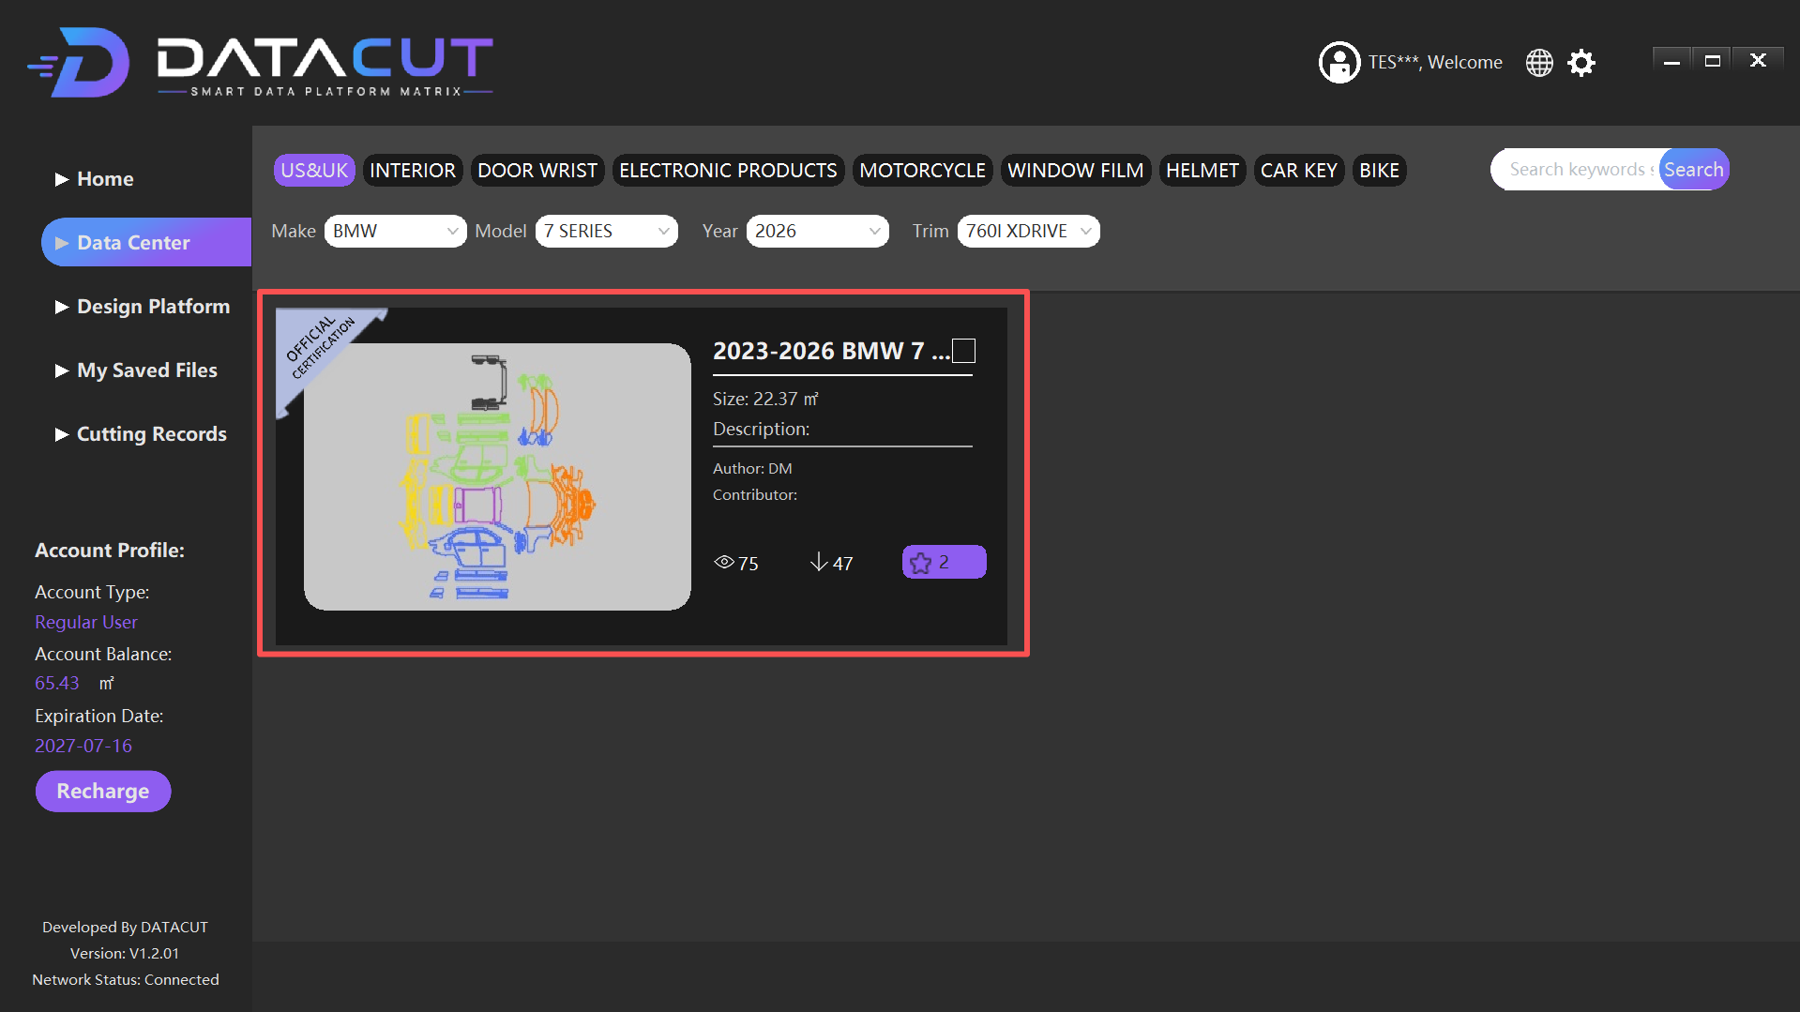
08 Entering the Design Platform
Enter the Design Platform from the Data Center
After selecting the model data, enter the Design Platform for film template editing
1
Confirm the target model data on the Data Center page
2
Select the data resources you need
3
Double-click the model data card, and the system automatically enters the Design Platform
4
It loads according to the data size and enters the Design Platform page
Loading notes:
• Keep the software running steadily during loading
• If you cannot enter, check: network connection, data permissions, remaining account resources
Notes:
After the model data filtering is done, we can enter the Design Platform. The operation is simple: confirm the target model data on the Data Center page, select the data resources you need, then double-click the model data card — the system will automatically enter the Design Platform. Depending on the data size, the loading time may vary; during loading, please keep the software running steadily and do not close it. If you cannot enter the Design Platform, check the network connection, data permissions, and remaining account resources.

Slide 12
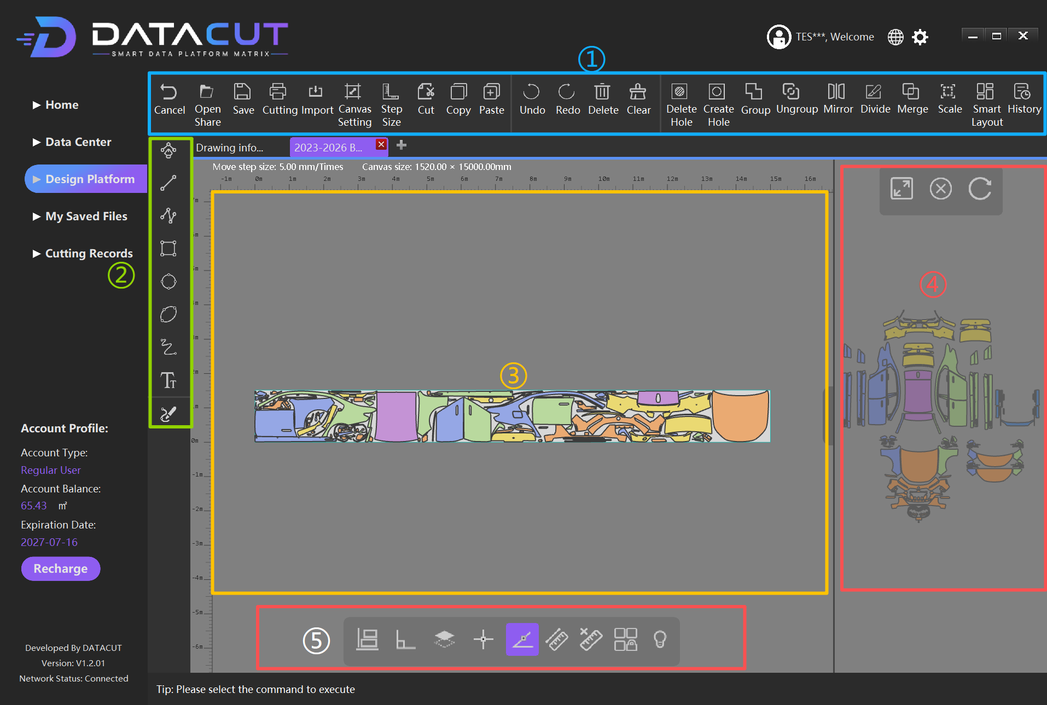
09 Design Platform Main Interface
Five Major Function Areas of the Design Platform
① Top Function Menu Bar
Provides design file processing and graphic editing tools, 24 function buttons in total
② Left Auxiliary Toolbar
Selection, line, node editing, shape, curve, text, and editing tools
③ Central Design Workspace
Main drawing workspace, displays the vehicle film unfolding data, supports editing operations
④ Right Preview Area
Displays the overall vehicle unfolding preview, for quickly locating parts and judging arrangement relationships
⑤ Bottom Quick Action Bar
Alignment tools, layer management, positioning aids, editing aids, smart tools
Notes:
After entering the Design Platform, we see that the main interface is divided into five major function areas: at the top is the function menu bar providing 24 design and editing function buttons; on the left is the auxiliary toolbar including drawing tools such as selection, line, node editing, shape, curve, and text; in the center is the design workspace displaying the vehicle film unfolding data — our main editing area; on the right is the preview area showing the overall vehicle unfolding preview for quickly locating parts; at the bottom is the quick action bar providing common tools such as alignment, layer management, and positioning aids. Getting familiar with these five areas is the basis for film template design.

Slide 13
09 Top Function Menu Bar Details
Six Major Function Categories
File Management
Canvas Settings
Editing Operations
Cancel — Exit the current operation
Open Share — Open shared files
Save — Save the design state
Cutting Import — Import cutting data
Canvas Setting — Canvas setting
Adjust the workspace width and length parameters
Step Size — Move step size setting
Controls the distance precision when moving objects
Cut / Copy / Paste — Cut/Copy/Paste
Undo / Redo — Undo/Redo
Delete / Clear — Delete/Clear
Shortcuts: Ctrl+X / Ctrl+C / DEL
Hole Handling
Object Grouping
Graphic Transformation & Layout
Delete Hole — Delete hole
Delete unneeded holes inside the film piece
Create Hole — Create hole
Create areas to be cut out on the film piece
Group — Group multiple objects into a whole
Ungroup — Ungroup and restore independence
After grouping, the whole can be moved, copied, and rotated
Without changing the shape of each part
Mirror / Divide / Merge — Mirror/Divide/Merge
Scale — Scale adjustment with proportional scaling
Smart Layout — Smart layout to optimize material utilization
History — View history records
Left Auxiliary Toolbar & Bottom Quick Action Bar
Left auxiliary toolbar:
Selection / Line / Node editing tools
Shape / Curve / Text / Editing tools
Bottom quick action bar:
Alignment tools / Layer management / Positioning aids
Editing aids / Smart tools
Notes:
The top function menu bar is the core toolbar of the Design Platform, with 24 function buttons in six major categories: File Management includes Cancel, Open Share, Save, and Cutting Import; Canvas Settings includes Canvas Setting and Step Size; Editing Operations includes Cut, Copy, Paste, Undo, Redo, Delete, and Clear; Hole Handling includes Delete Hole and Create Hole; Object Grouping includes Group and Ungroup; Graphic Transformation & Layout includes Mirror, Divide, Merge, Scale, Smart Layout, and History. The left side has the drawing auxiliary tools, and the bottom is the quick action bar. We will explain the usage of each function in detail later.

Slide 14
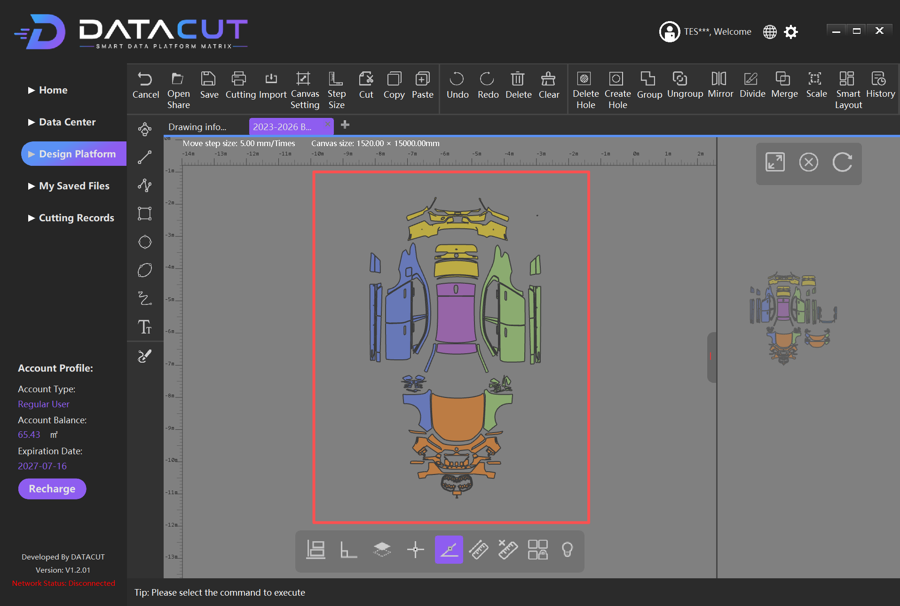
10 Design Workspace Introduction
Central Drawing Workspace
After entering the Design Platform, the central area is the main drawing workspace,
supporting zoom in/out, moving, and editing operations
Workspace Display Content
• Vehicle exterior film unfolding data
• Different colors represent different vehicle part areas
• The unfolded parts are arranged according to actual processing needs
• Supports zoom in/out, moving, and editing operations
Body Areas Included in the Design File
• Body coverage area
• Door area
• Front and rear bumpers
• Roof area
• Side skirt area
• Other body accessory areas
Notes:
The design workspace is the main place for film template editing. After entering the Design Platform, the central area displays the vehicle exterior film unfolding data; different colors represent different vehicle part areas, and the unfolded parts are arranged according to actual processing needs. You can zoom in/out and move the workspace for easy viewing and editing of details. The design file usually includes the body coverage area, door area, front and rear bumpers, roof area, side skirt area, and other body accessory areas. Users can adjust the unfolding data in various ways according to production needs.

Slide 15
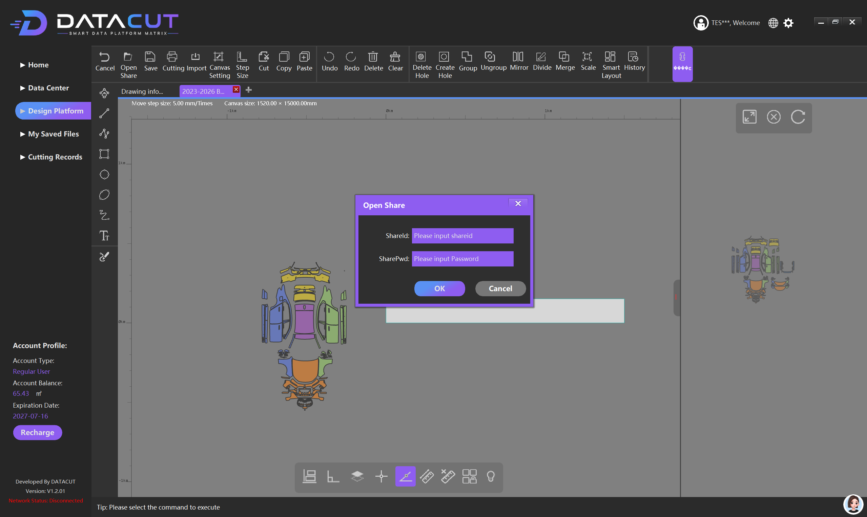
11 Detailed Features ① File Management & Canvas Settings
Open Share
Function:Open design data shared by other users via the share ID and password
Operation:Enter ShareId + SharePwd → click OK
Use cases:
• Data collaboration (designers/processors/shops)
• Cross-device access without re-searching the model
• Project file handover and remote technical support

Slide 16
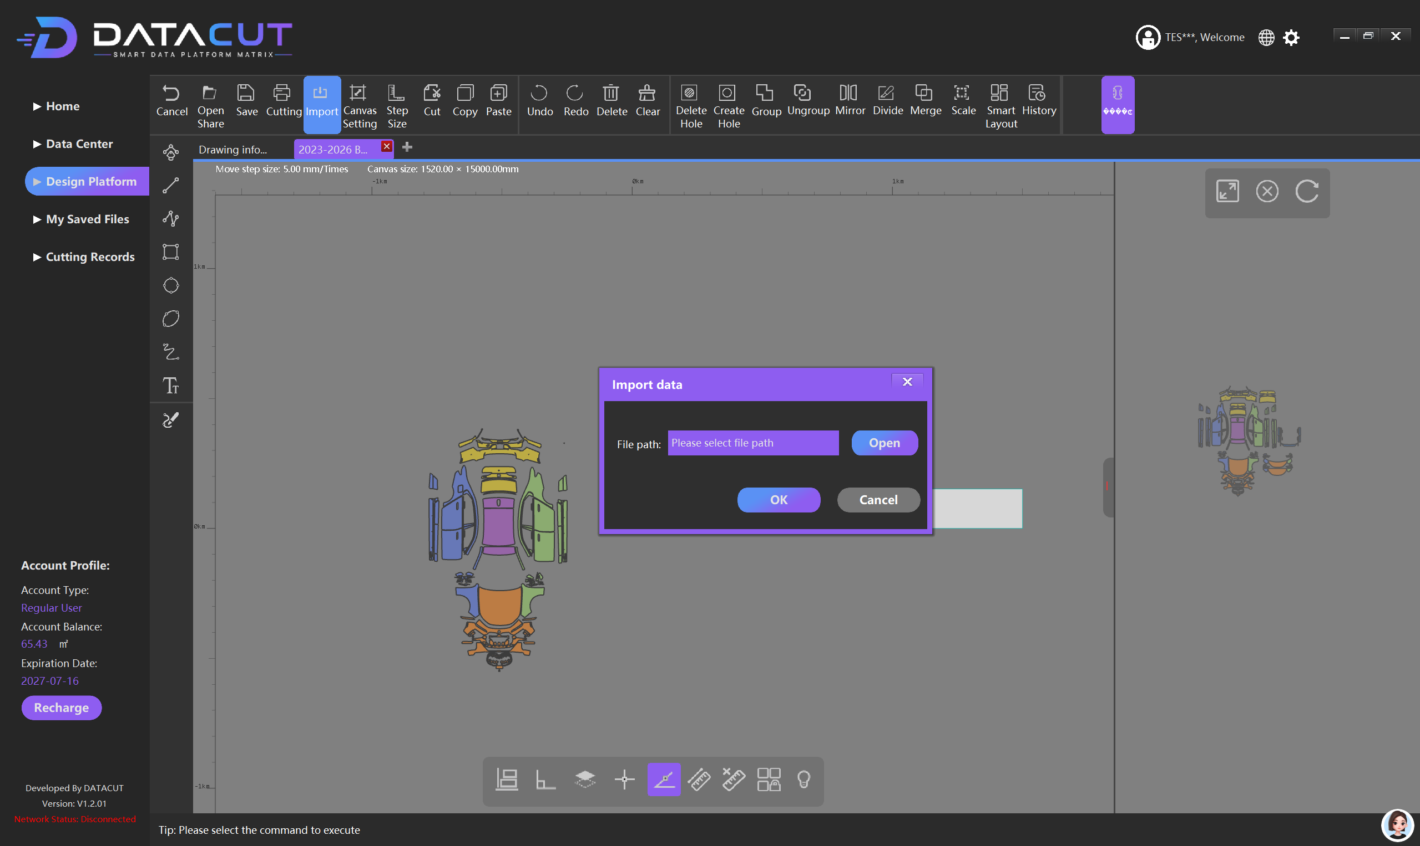
Import Data
Function:Import external design data
Supported formats:
• Graphic files
• Cutting data
Steps:
1. Click Import
2. Select the file path
3. Click Open
4. Click OK to finish importing

Slide 17
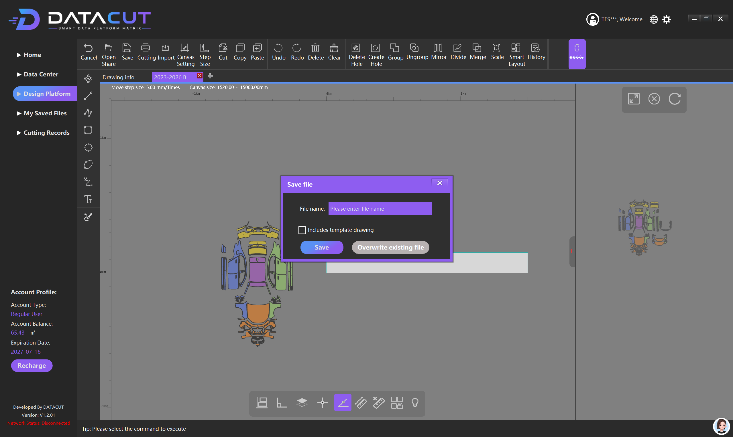
Save
Function:Save the vehicle film cutting design file currently being edited
Use cases:
• Save after finishing graphic adjustments
• Save after finishing layout modifications
• Save after finishing path editing
• Save after finishing dimension adjustments
Purpose:Avoid data loss; regular saving is recommended
Notes:
Let's first look at the File Management and Canvas Settings functions. Save is used to save the current design file — it is recommended to save regularly during operation to avoid data loss. Open Share is used to open design data shared by other users via the share ID and password, suitable for team collaboration and cross-device access. Import Data is used to import external graphic files or cutting data. Canvas Setting is used to set the canvas width and length according to the actual film material specifications. Step Size controls the distance precision when moving objects — a smaller value means higher precision, and a larger value means higher moving efficiency.

Slide 18
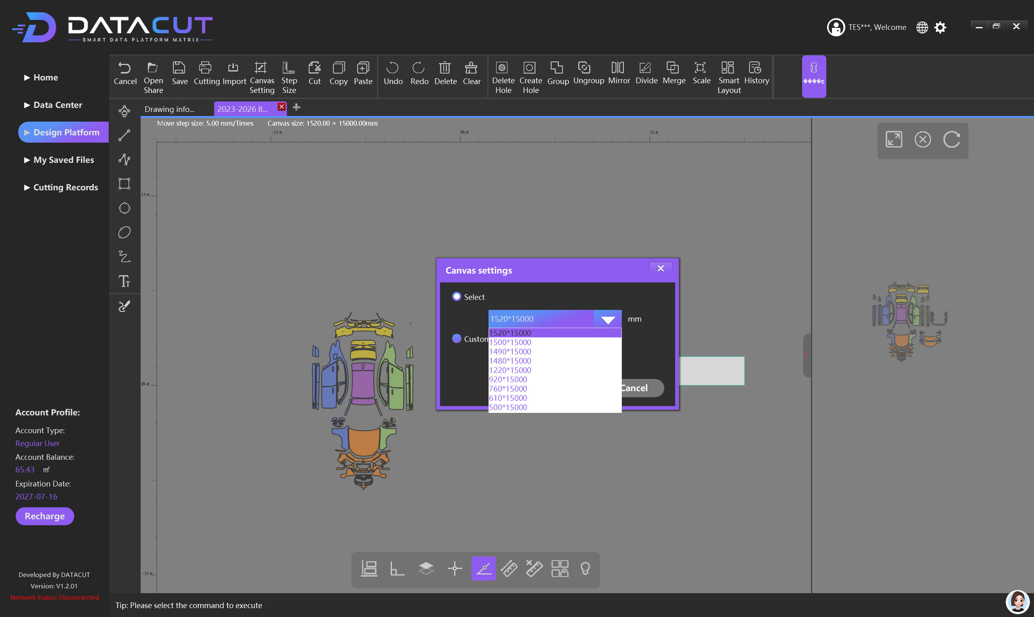
Canvas Setting
Function:Adjust workspace parameters
Configurable parameters:
• Width (based on material specifications)
• Length (based on material specifications)
Description:
Based on the specifications of the film material actually used,
set the corresponding canvas size,
to ensure the layout matches the actual material

Slide 19
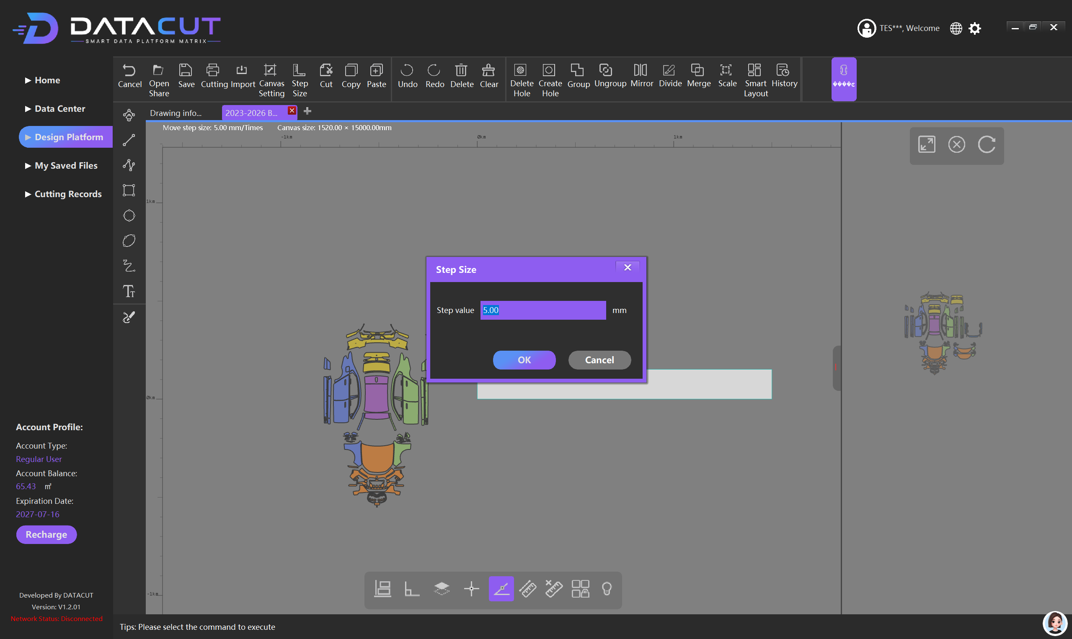
Step Size
Function:Controls the distance precision when moving objects
Parameter description:
• The smaller the value, the higher the adjustment precision
• The larger the value, the higher the moving efficiency
Usage tips:
Use a smaller step for fine adjustments,
use a larger step for large-range movements,
and switch flexibly according to actual operating needs

Slide 20
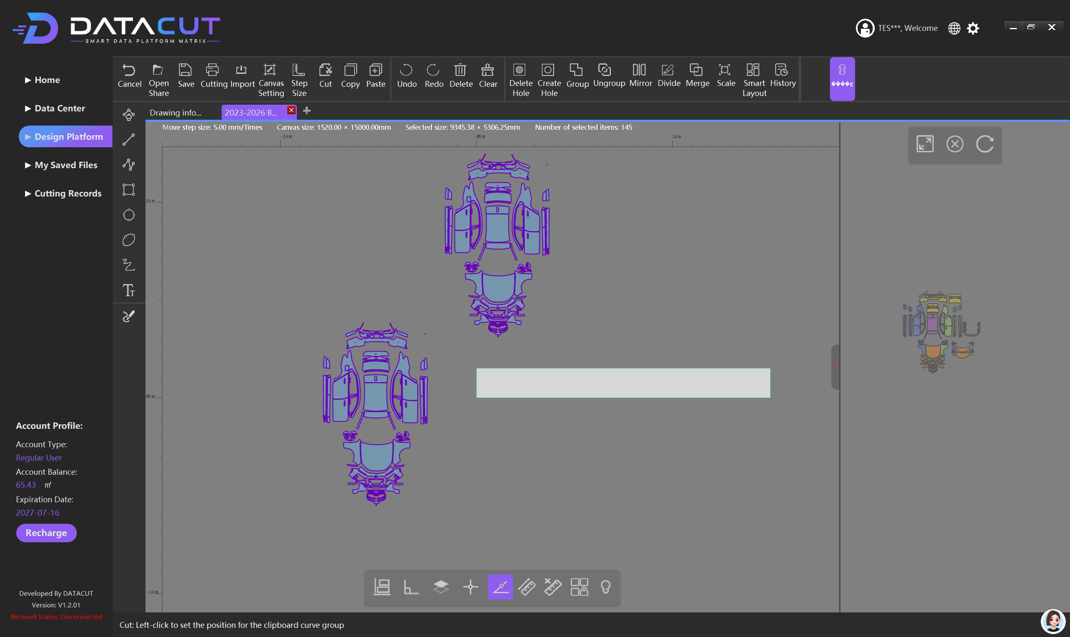
11 Detailed Features ② Editing Operations
Cut
Function:Removes the selected object and stores it in the clipboard
Operation:Select object → Cut → Paste
Shortcut:Ctrl + X
Use case:
• Move objects to other positions
• Adjust the design layout
• Change the graphic arrangement
Notes:
Next are the Editing Operations functions. Cut removes the selected object and stores it in the clipboard — shortcut Ctrl+X — combined with Paste to move objects. Copy duplicates the selected object — shortcut Ctrl+C — combined with Paste to quickly create identical graphics. Undo returns to the previous step, and Redo restores an undone operation — both are very useful for mistakes. Delete removes the selected object; the DEL key also works. Clear empties all parts in the current design platform at once, restoring the canvas to a blank state — confirm that the needed files have been saved before using it.

Slide 21
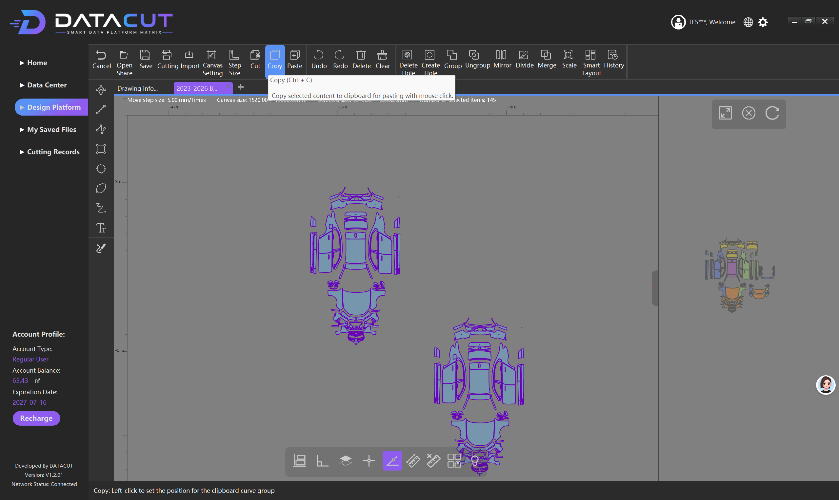
Copy
Function:Copies the selected object and stores it in the clipboard
Operation:Select object → Copy → Paste
Shortcut:Ctrl + C
Use case:
• Quickly create identical graphics
• Duplicate template parts
• Improve layout design efficiency

Slide 22
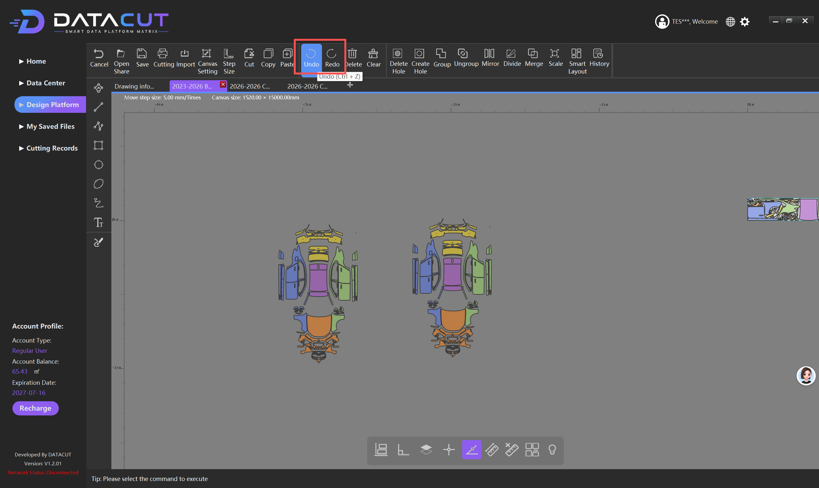
Undo / Redo
Undo:Reverses the most recent operation
• Restore mistakenly deleted graphics
• Cancel wrong movements
• Click repeatedly to go back step by step
Redo:Restores an undone operation
• Only valid after Undo
• New edits clear the Redo history

Slide 23
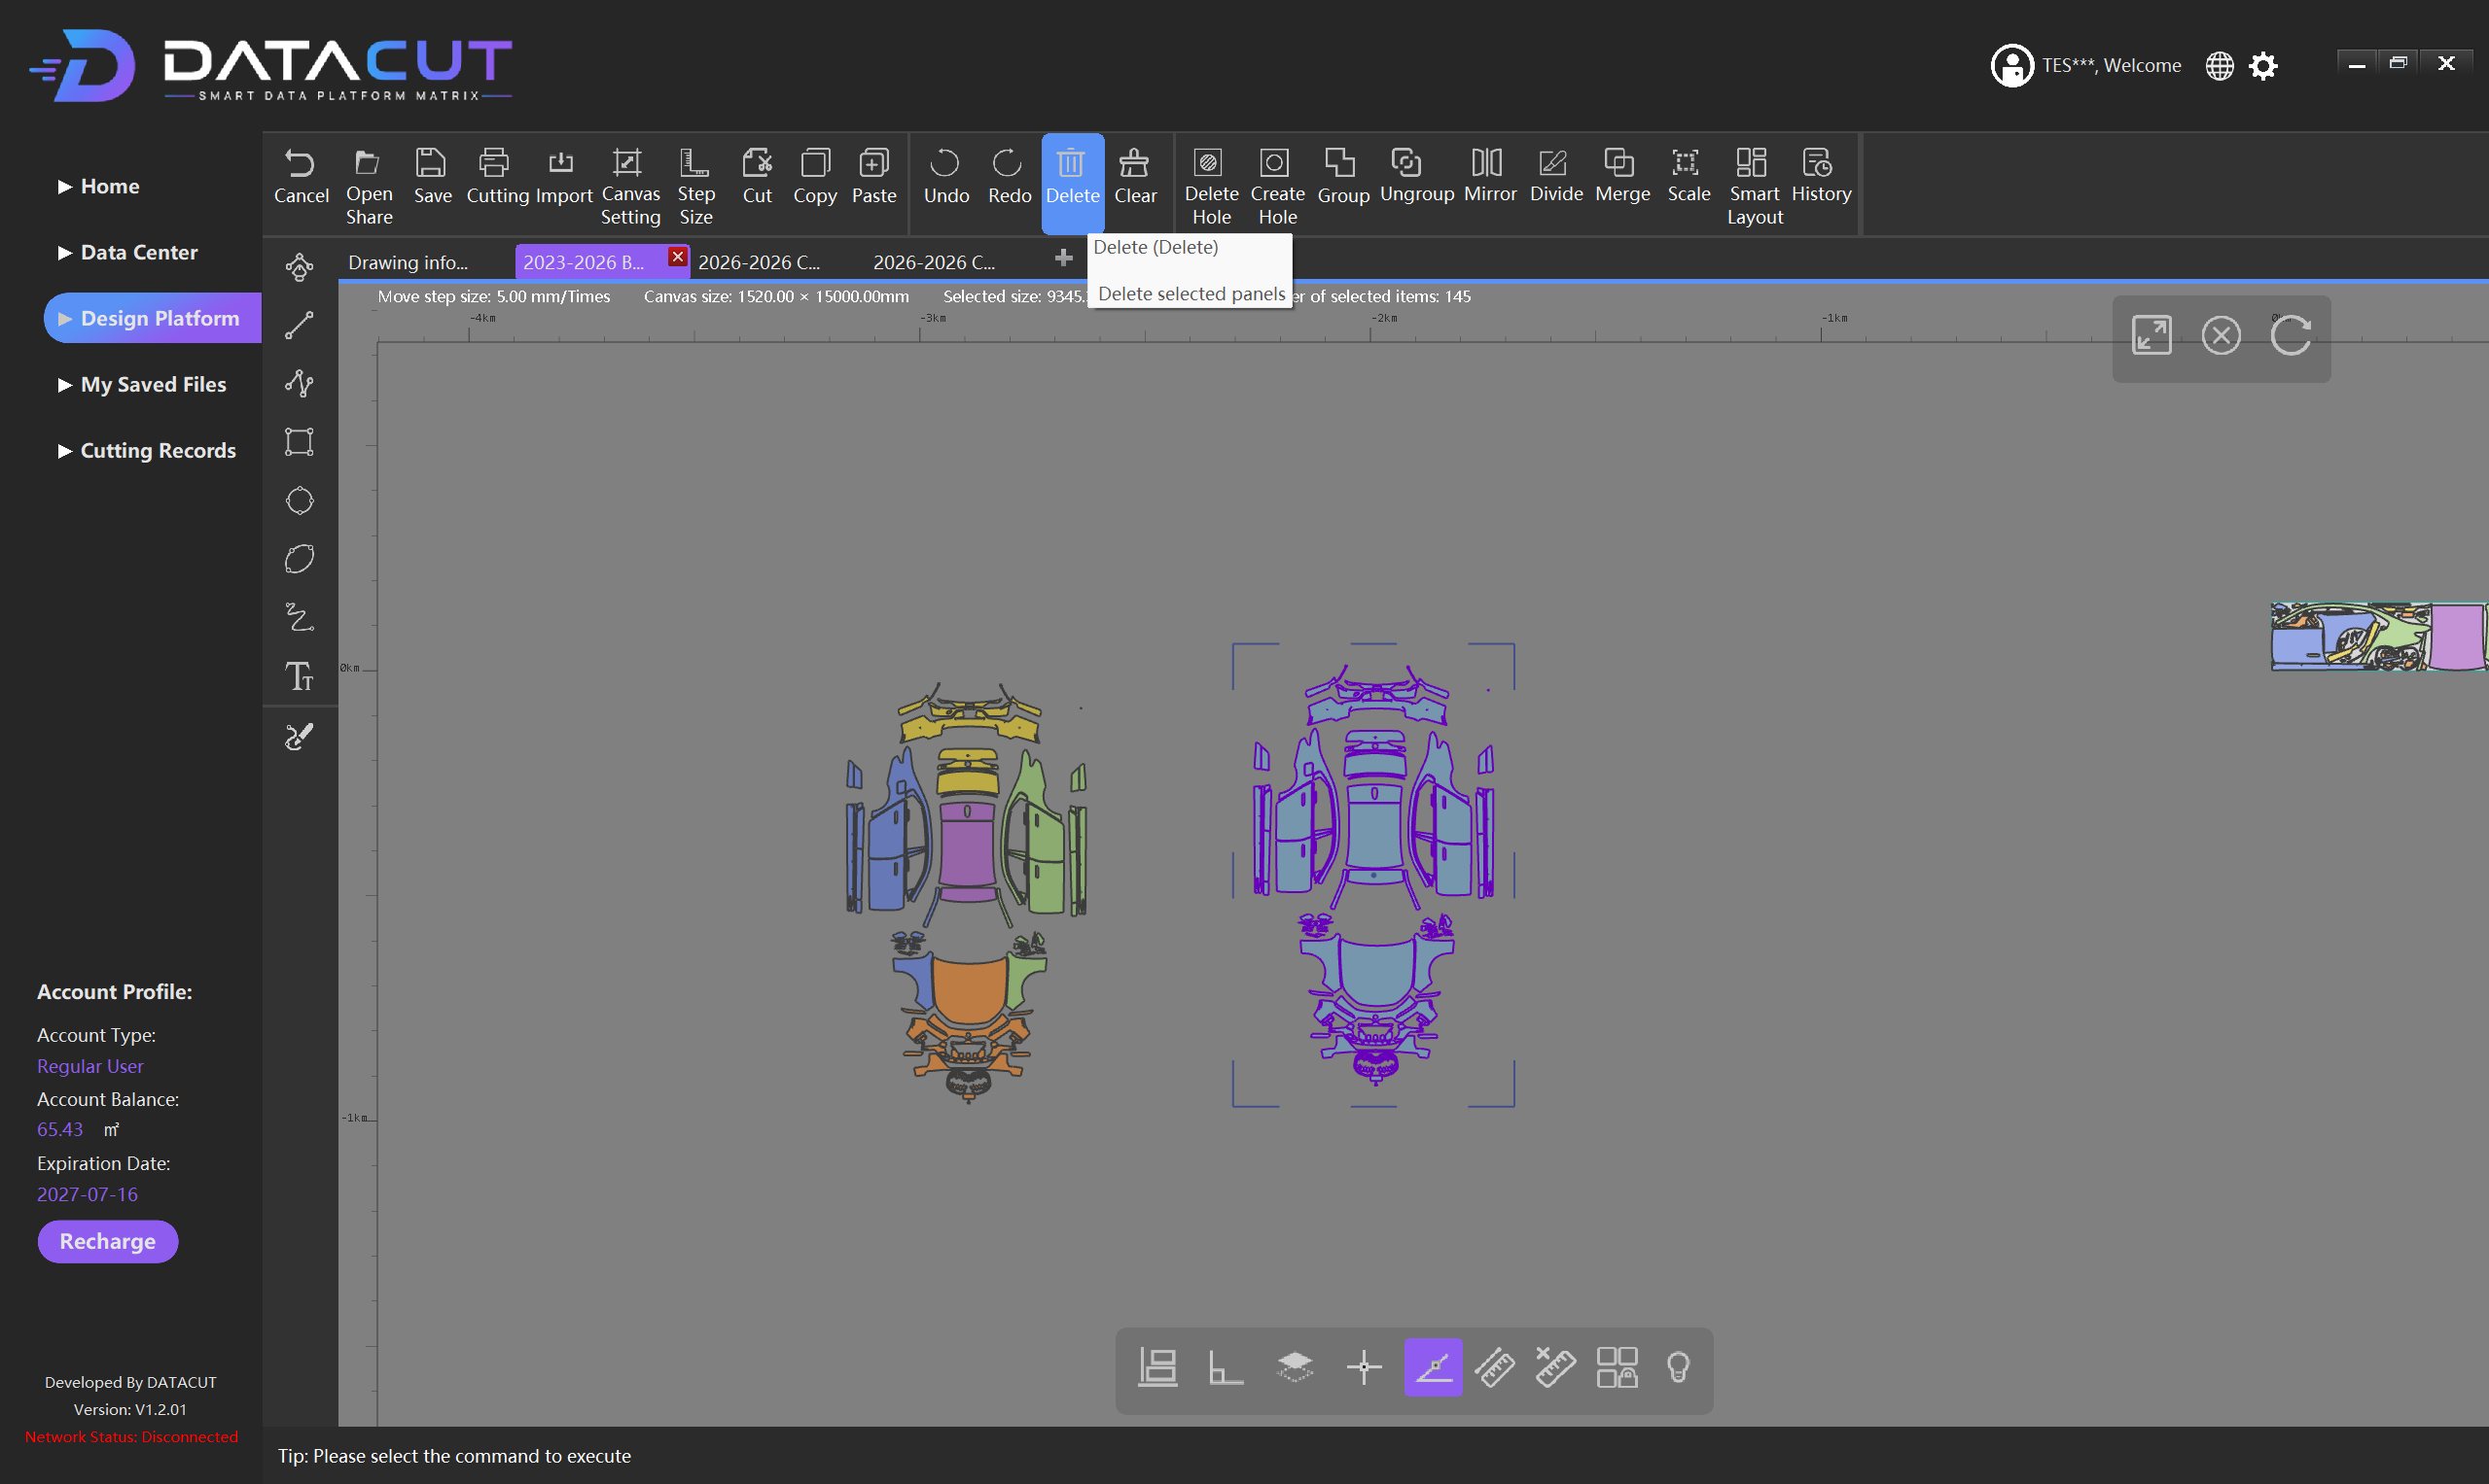
Delete
Function:Deletes the currently selected design object or part
Operation:
1. Select the object to delete in the workspace
2. The selected object shows a selected state
3. Click Delete or press the DEL key
4. The software deletes the currently selected design element
Note:You can use Undo to restore after deletion

Slide 24
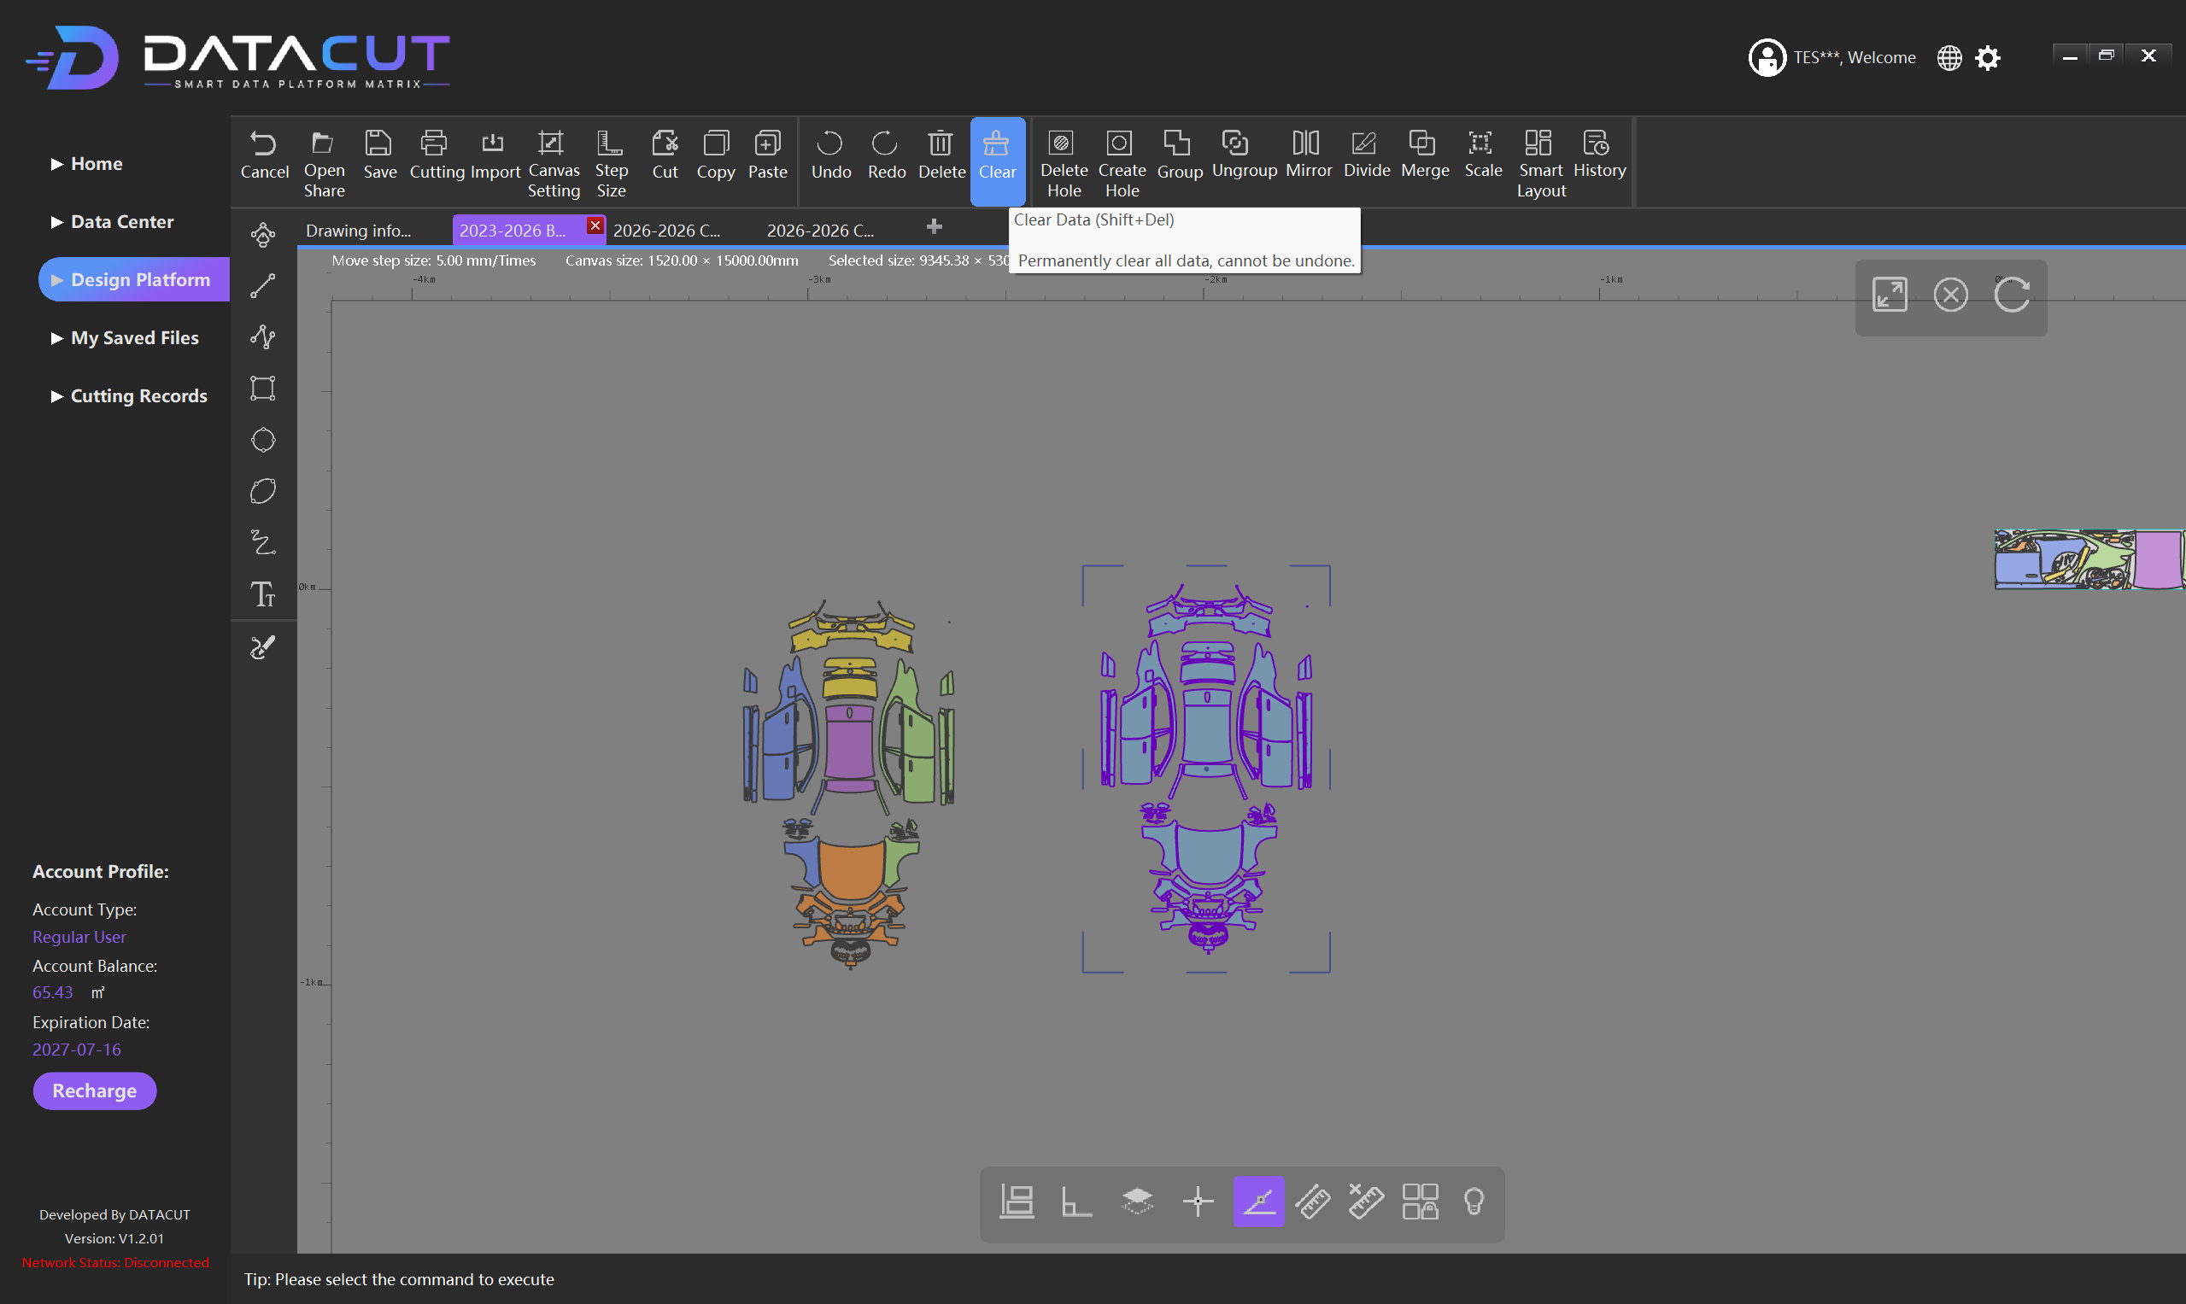
Clear
Function:Empties all design parts in the current design platform
Effect:All parts are removed at once, and the canvas becomes blank again
Use cases:
• Empty the current design area
• Start a new design task from scratch
• Remove all parts on the current page
• Clean up before importing new template data
Note:Before the operation, confirm that the needed files have been saved

Slide 25
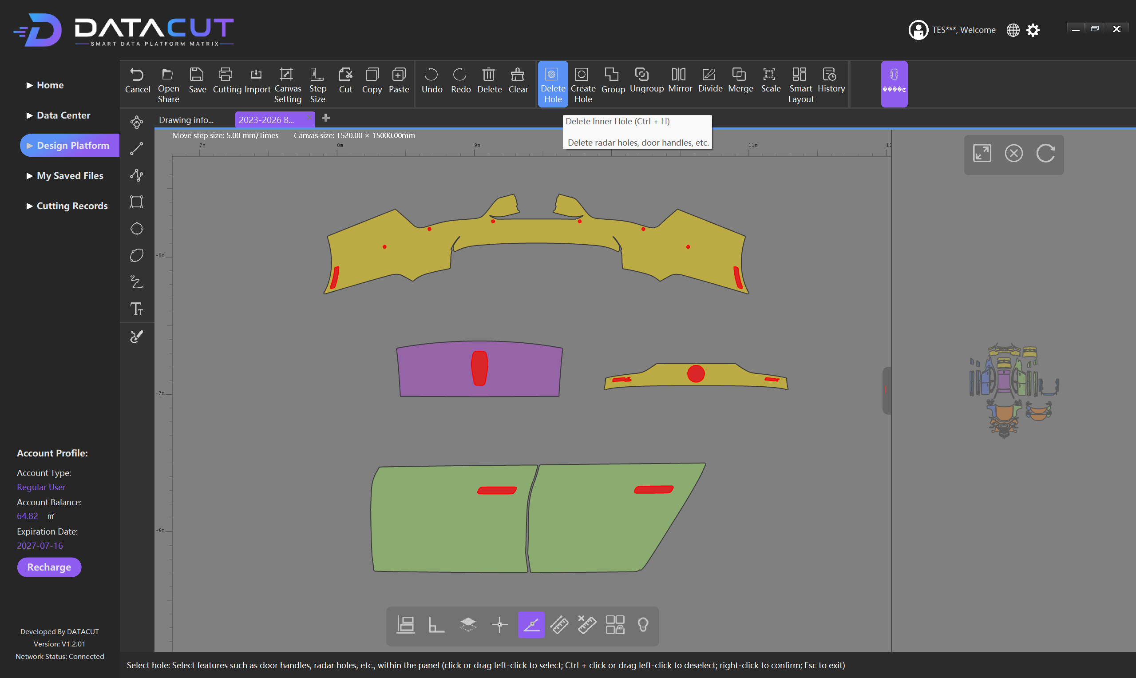
11 Detailed Features ③ Hole Handling & Object Grouping
Delete Hole
Function:Deletes internal holes or cut-out areas on the selected film piece
Use case:A hole exists but is not needed in actual film cutting
Steps:
1. Select the film part to edit
2. Select the hole area inside the film to delete (it turns red)
3. Right-click on a blank area to delete the selected hole
4. Check that the hole has disappeared and the film outline remains unchanged
Note:Only targets internal holes; not the same as Delete which removes objects
Notes:
Hole handling and object grouping functions. Delete Hole deletes unneeded holes inside a film piece: select the film, select the hole area, then right-click to delete. Note that this only targets internal holes and is not the same as Delete which removes the whole object. Create Hole creates areas to be cut out on a film piece, such as sensor positions or screw holes. After creation, check that the hole position and size match the actual vehicle. Group combines multiple parts into a whole for easy overall movement and operation. Ungroup releases the grouping and restores each part to independent operation. Neither function changes the shape of the parts themselves.

Slide 26
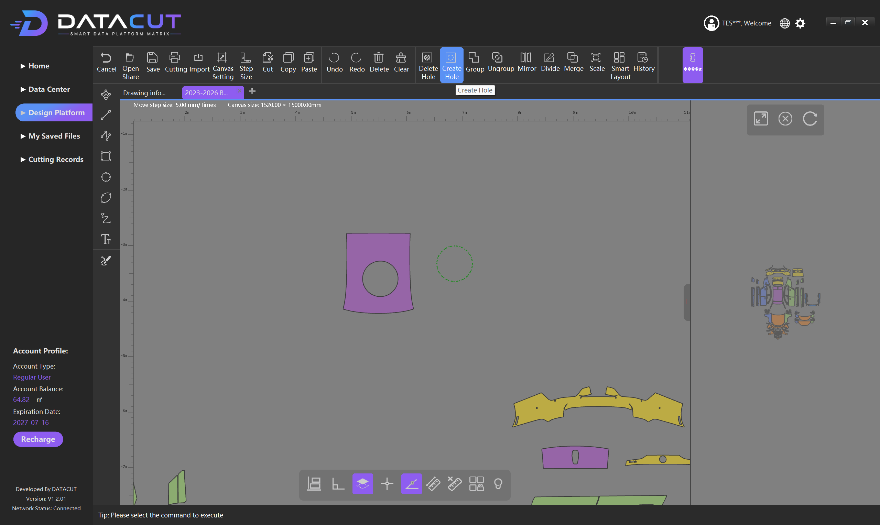
Create Hole
Function:Creates internal holes (cut-out areas) on an existing film piece
Use case:Sensor areas, screw holes, decorative structures, areas not to be covered
Steps:
1. Select the target film piece for hole creation
2. Click Create Hole on the top toolbar
3. Follow the prompts to create the cut-out area inside the film
4. After completion, check whether a new cut-out area has formed inside the film
Note:Ensure the hole is within the valid area, and check that the position and size match the actual vehicle

Slide 27
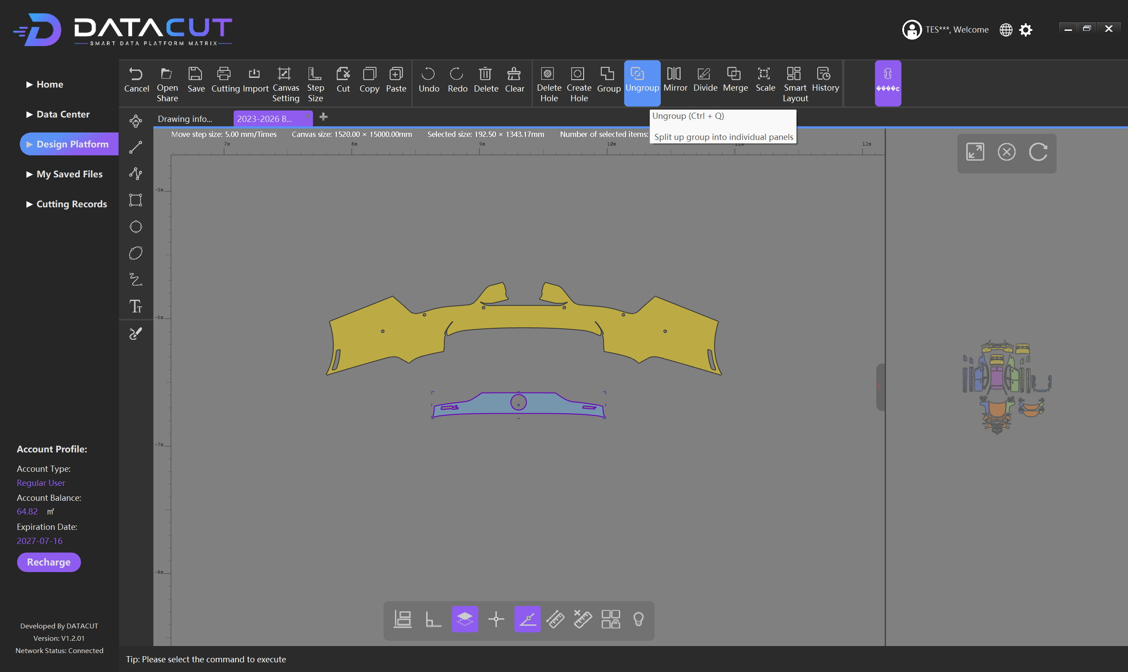
Ungroup
Function:Releases grouped parts and restores independent operation
After releasing, each can be operated separately:Move, delete, rotate, scale, edit
Steps:
1. Click a grouped object
2. Click Ungroup on the top toolbar
3. Confirm the split result; each part returns to an independent state
4. Each part can then be edited separately
Note:Only releases the grouping relationship; no parts are deleted

Slide 28
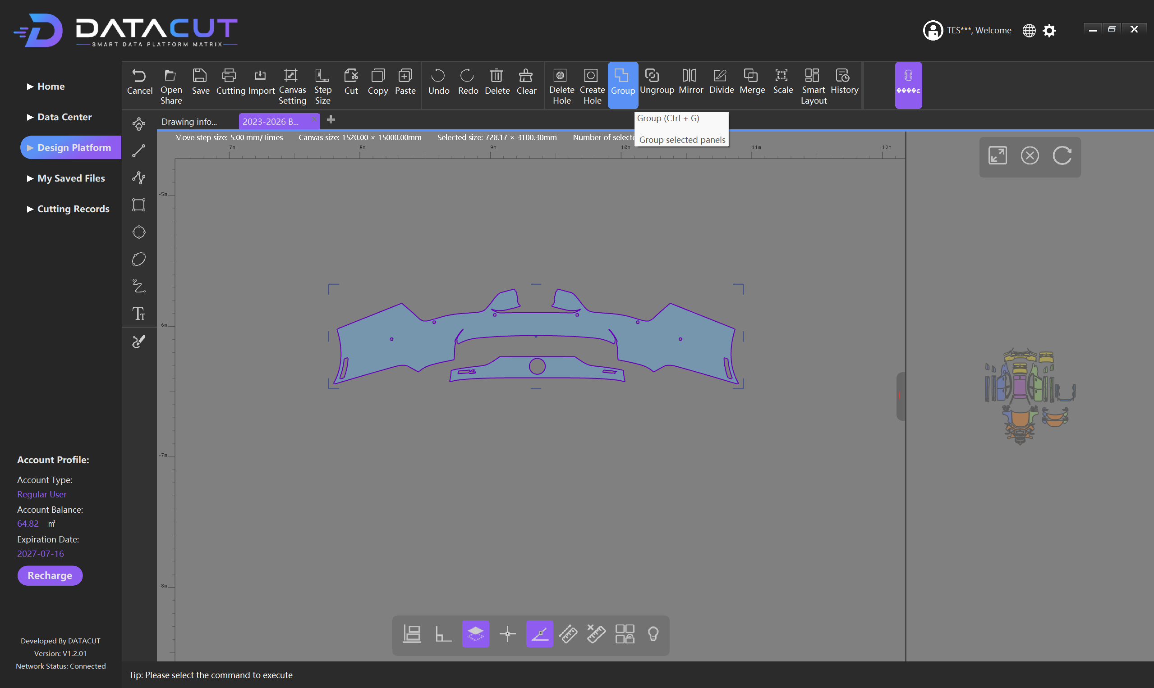
Group
Function:Combines multiple independent parts into a whole
After grouping, the whole can be operated:Move, copy, rotate, scale, lay out
Steps:
1. Box-select or individually select the parts to group
2. Confirm that all parts are selected
3. Click Group, and the software combines the objects into a whole
4. After grouping, you can drag the whole grouped object directly
Note:Does not change the shape of each part, only the operation relationship

Slide 29
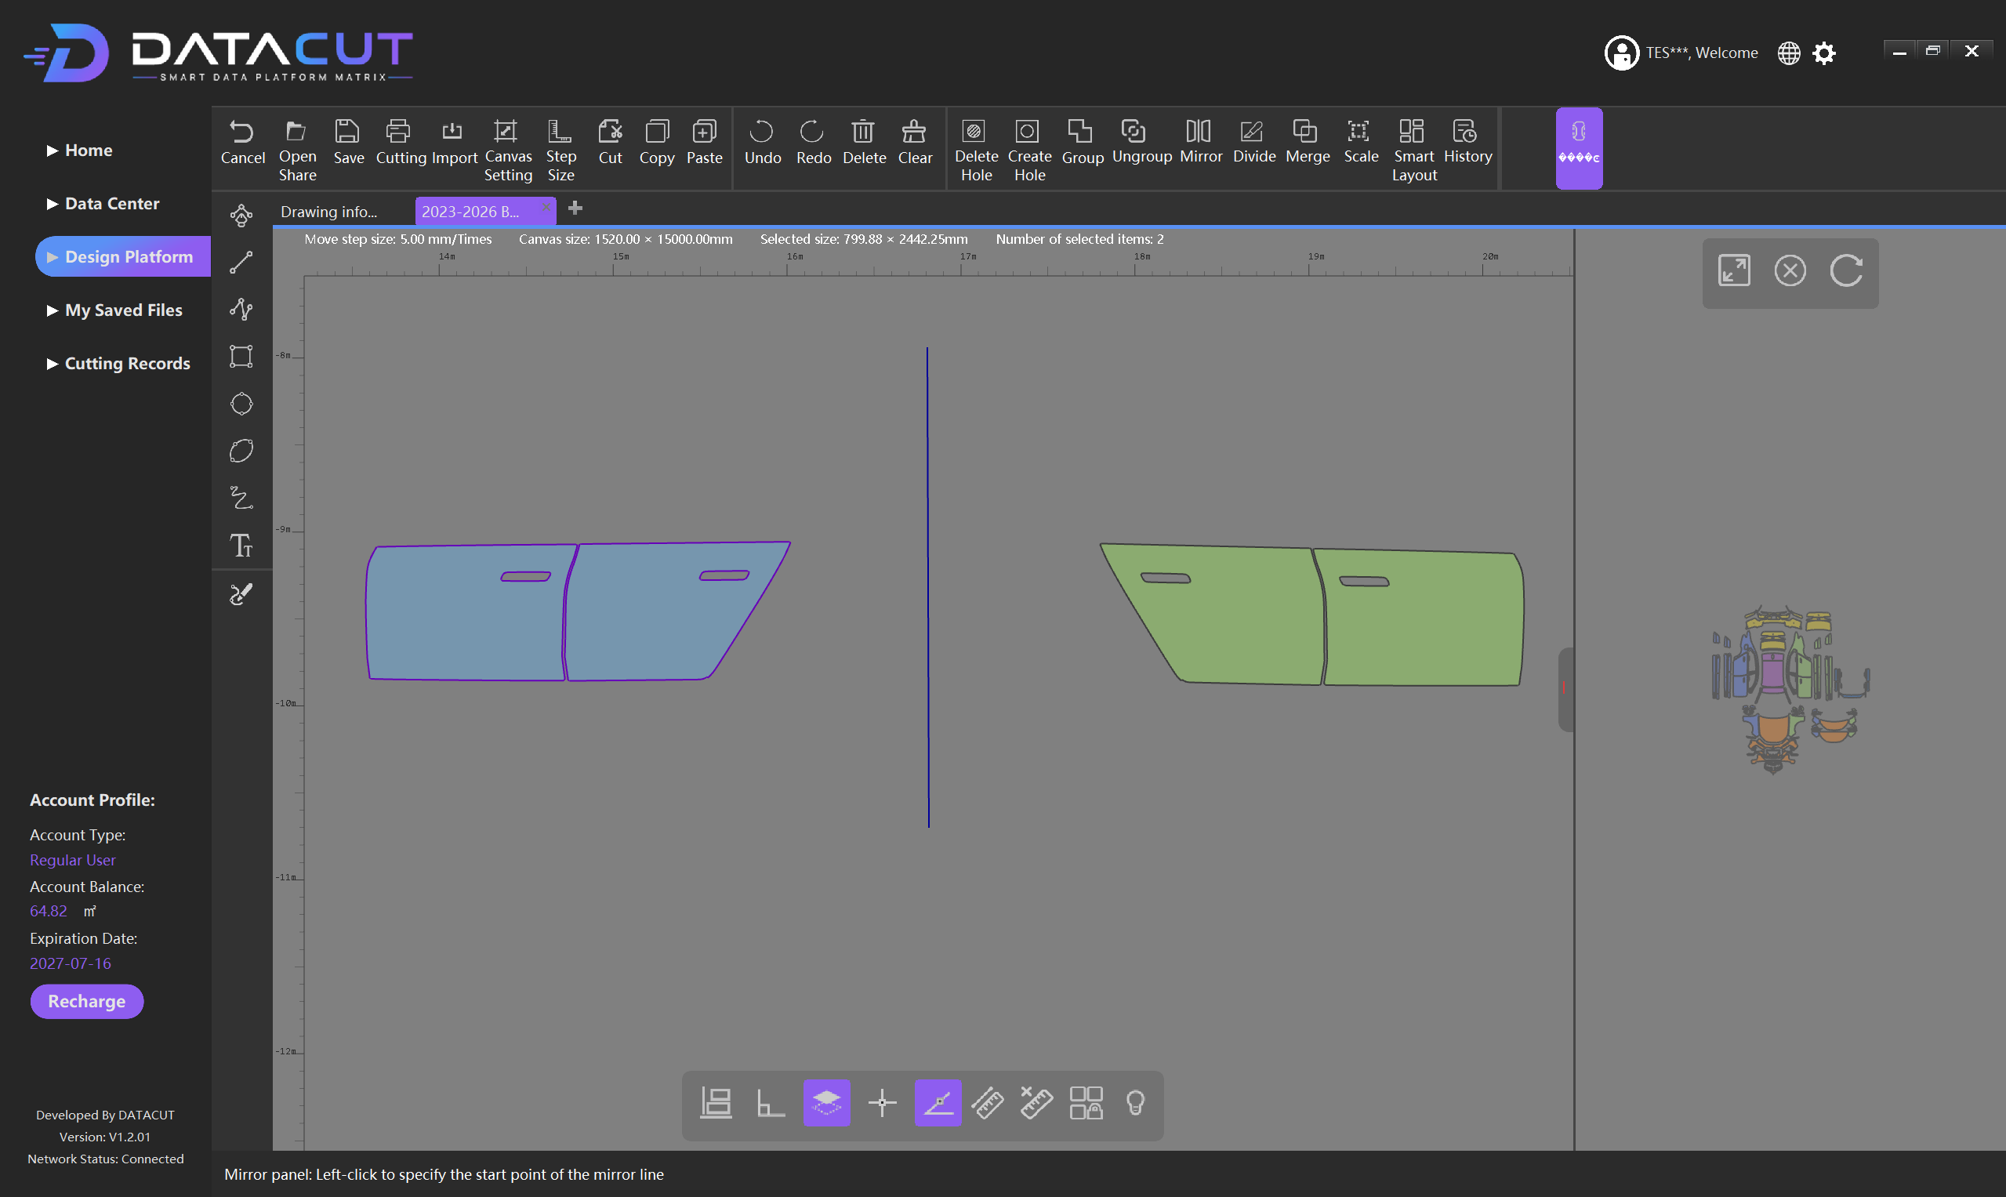
11 Detailed Features ④ Graphic Transformation
Mirror
Function:Mirrors the selected film piece or graphic
Use case:Handling left-right symmetric vehicle parts (generating the right door from the left door)
Operation:Select the target film → click Mirror → draw a horizontal line → right-click to confirm
Check points:
• Whether the left-right direction is correct
• Graphic dimensions, positioning holes, special structures
• Whether the curved outline meets requirements
Note:Do not judge merely by "looks symmetric" — check item by item
Notes:
Graphic transformation functions. Mirror flips a film piece, especially suitable for left-right symmetric vehicle parts, such as generating the right door film from the left one. You need to draw a horizontal line and then right-click to confirm; after mirroring, always check the left-right direction, dimensions, positioning holes, and curved outline. Divide splits a large film piece into multiple independent parts, suitable for segmented installation or material size limits. Merge combines two overlapping parts into one whole — the reverse of Divide. Scale adjusts the overall size of parts; the X and Y scale factors can be set separately, and it is recommended to check Maintain aspect ratio to avoid film distortion.

Slide 30
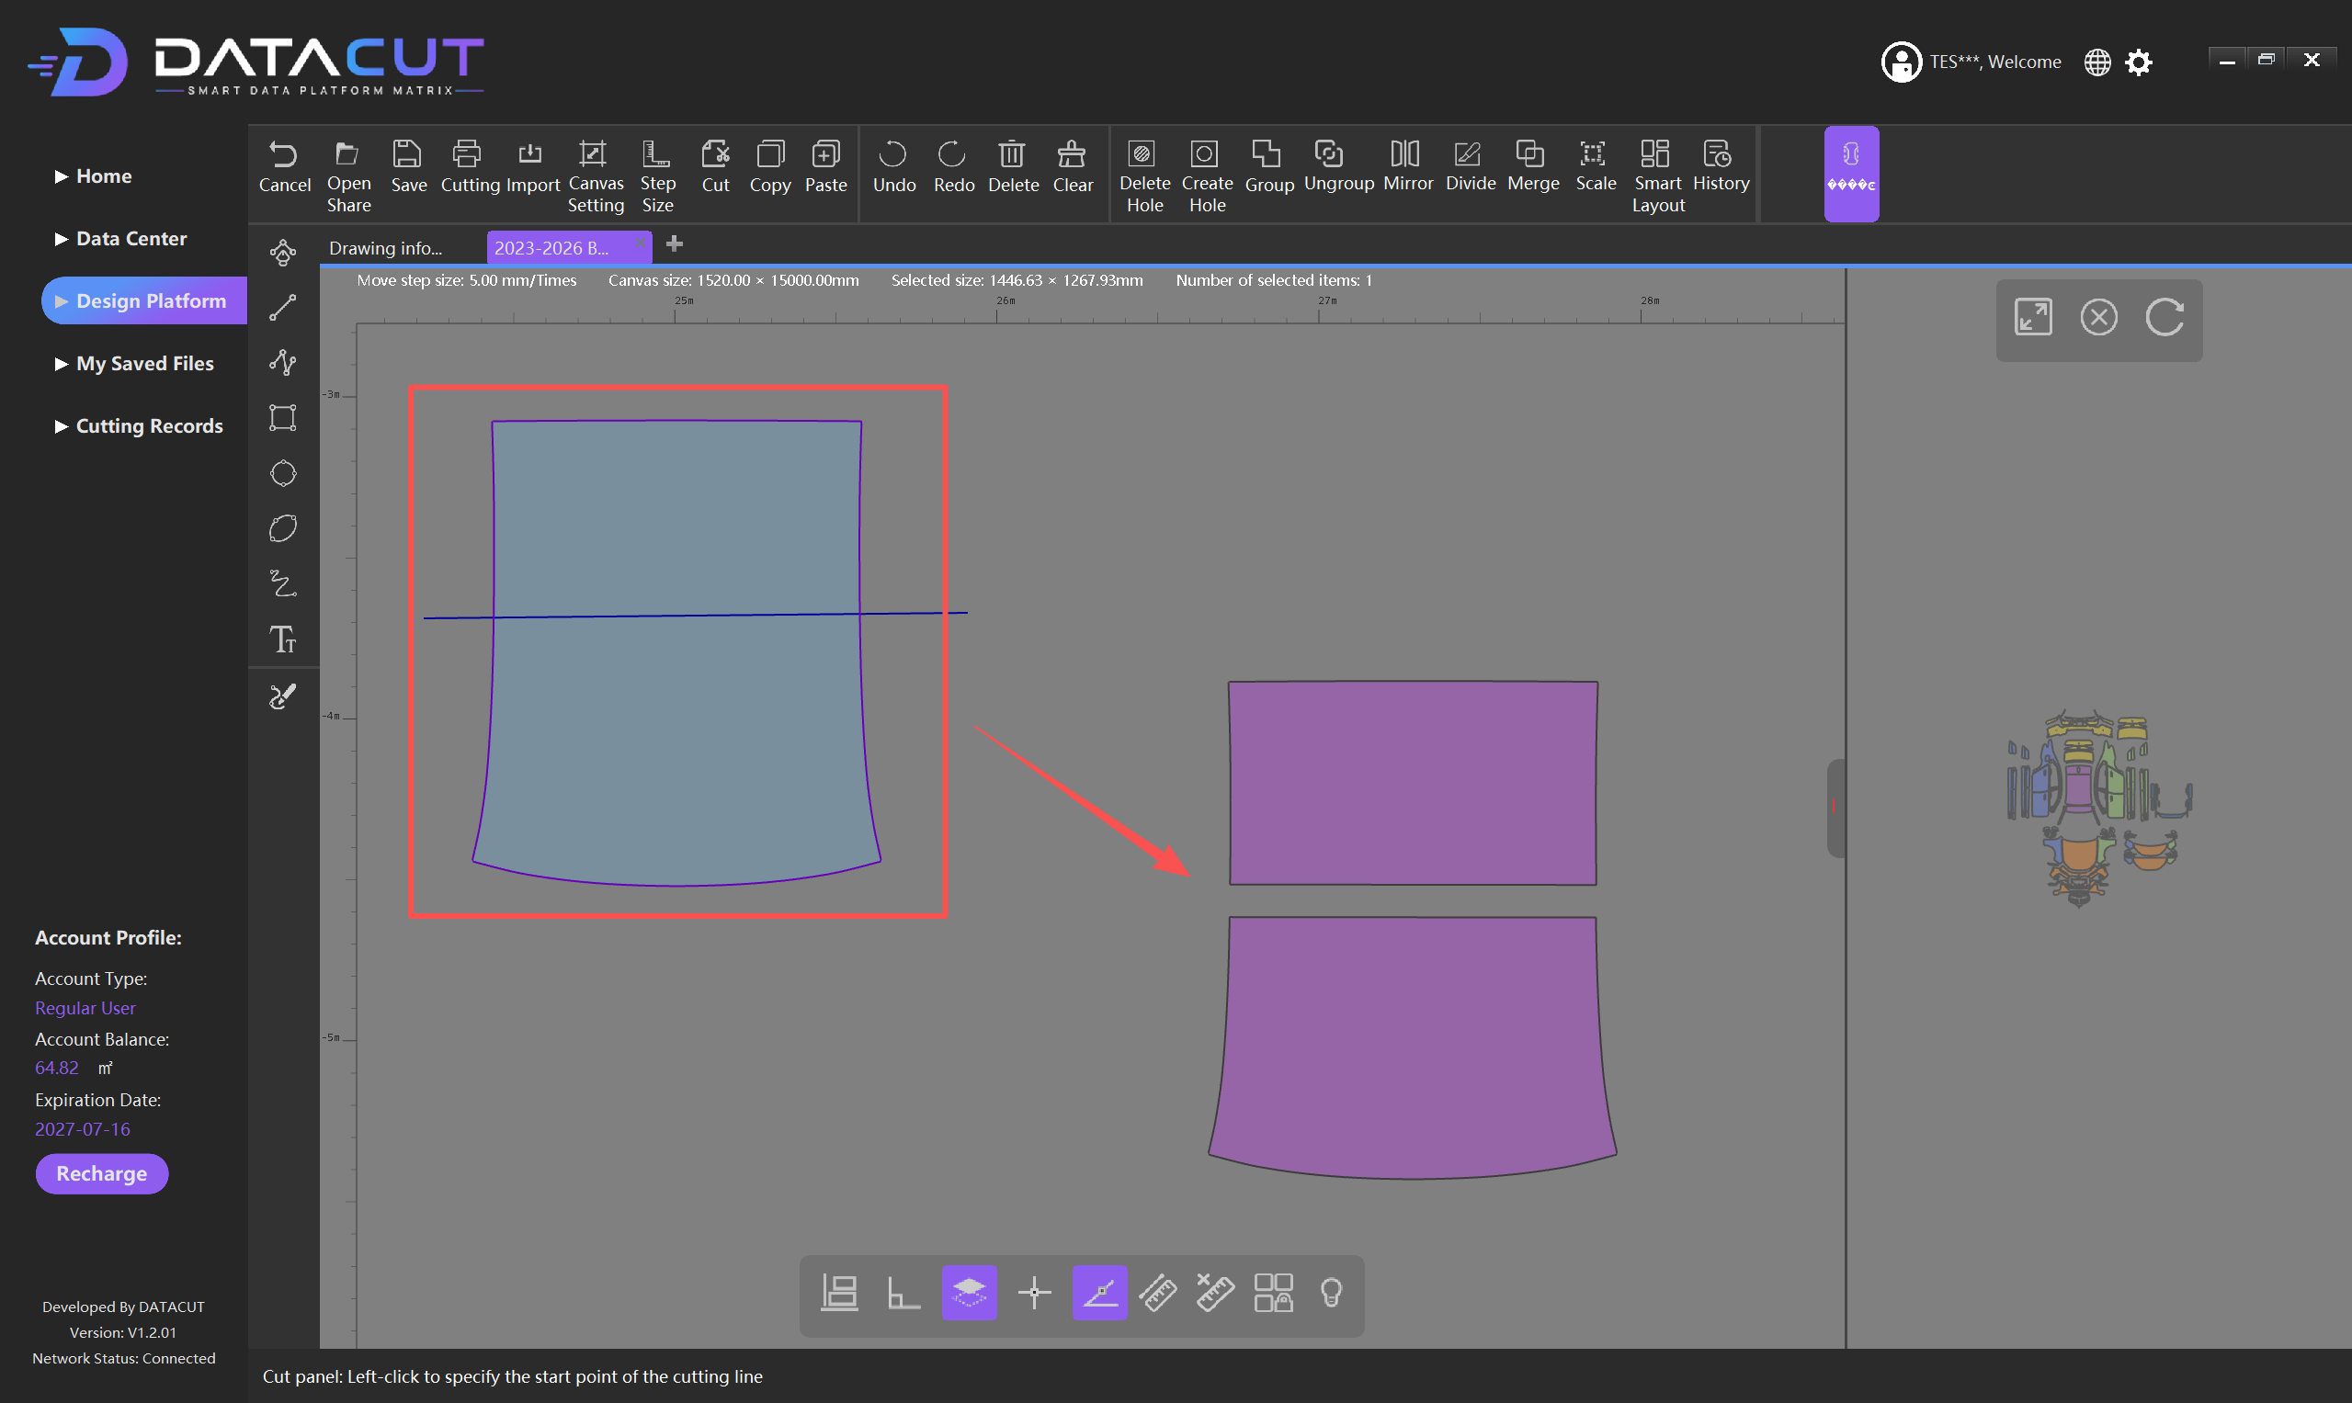
Divide
Function:Splits a complete film piece into multiple independent parts at specified positions
Use case:Film piece too large, segmented installation needed, or material size limits
Operation:Select the target film → click Divide → set the split position → finish splitting
After splitting, each part can be separately:Moved, rotated, laid out, deleted, modified
Note:
• Set the split position based on installation needs and material width
• Unreasonable splits may cause splicing difficulties and unreasonable seams

Slide 31
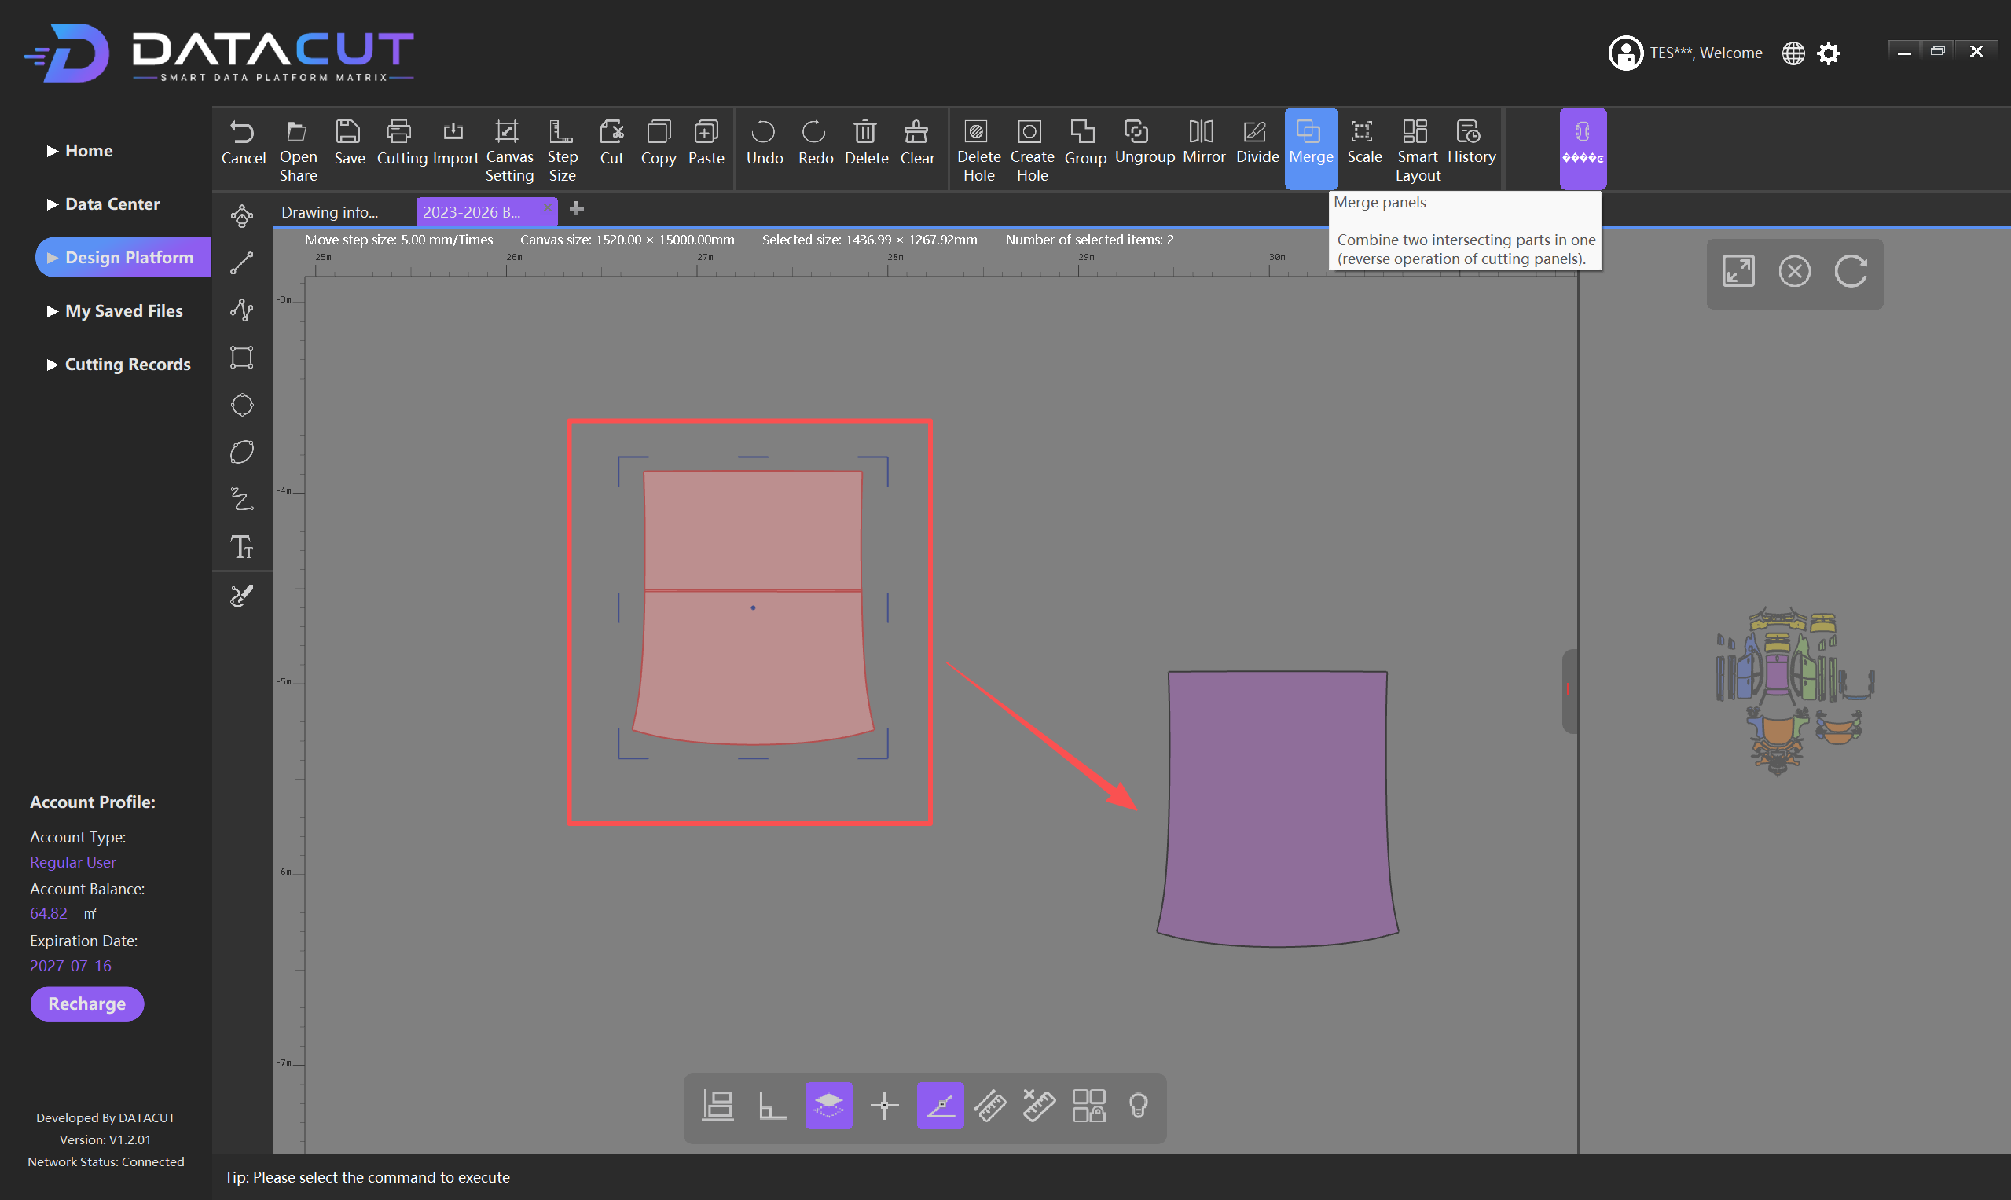
Merge
Function:Combines two overlapping parts into one whole
Description:The software automatically recognizes the overlapping area and handles the boundary — the reverse of Divide
Operation:
1. Select the two parts to merge (they must overlap)
2. Confirm the overlapping area (highlighted in red)
3. Click Merge, and the software handles the overlapping boundary automatically
4. Check the merge result; reselect the object to confirm completion
Note:Only applies to parts that overlap

Slide 32
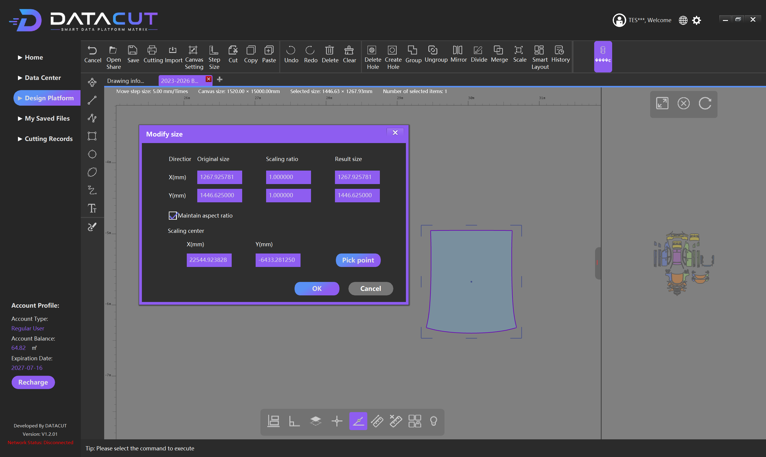
Scale
Function:Adjusts the overall size of the selected part
Configurable:X-direction scale factor, Y-direction scale factor
Maintain aspect ratio:Keep the aspect ratio to avoid film distortion
Scaling Center:The scaling center; a reference point can be specified manually
Scale notes:1.000000 = original size, 2.000000 = 2x enlarged
Recommendation:Original paint protection film pieces should usually keep the aspect ratio
Operation:Select the part → click Scale → set the parameters → confirm scaling

Slide 33
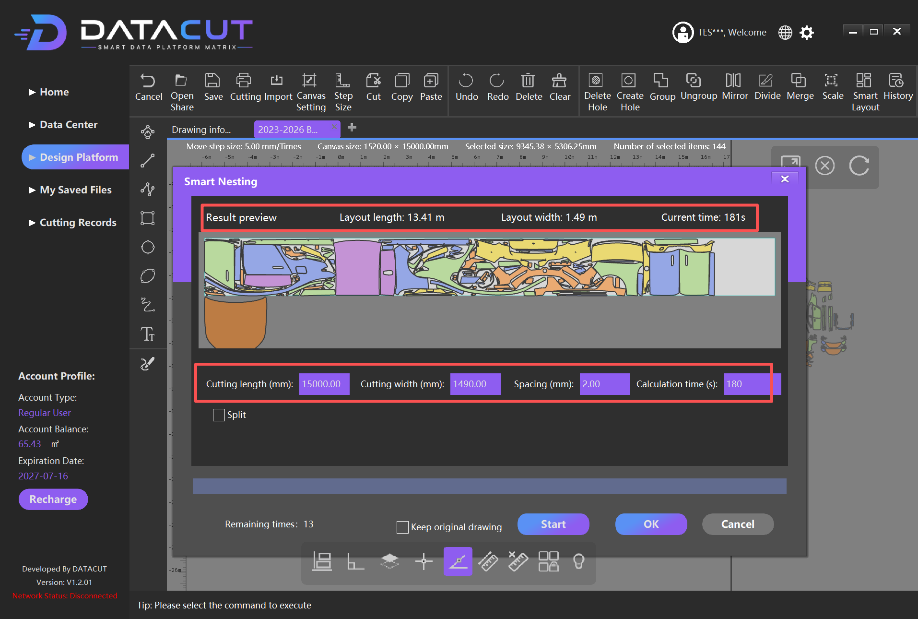
11 Detailed Features ⑤ Smart Layout & History
Smart Layout
Function:Automatically optimizes the layout positions of multiple film parts to improve material utilization
Use case:Process a large number of paint protection film parts at once
Steps
1. Prepare all film pieces to lay out (different body areas, parts already divided/mirrored/scaled)
2. Select the objects to auto-layout; the software shows the selected count
3. Click Smart Layout to enter the Smart Nesting interface
4. Set the parameters and click Start to run the smart layout
Smart Nesting Parameter Settings
Parameter | Description
Cutting length | Material length, e.g. 15000.00 mm (15 m)
Cutting width | Effective material width, e.g. 1490.00 mm
Spacing | Safety spacing between parts, e.g. 2.00 mm
Calculation time Split | Smart layout calculation time; the longer, the more chances to optimize Sectioning function: the auto-layout task can be divided into different lengths,3m/4m/5mor with custom lengths
Important notes:The layout can be adjusted manually afterwards, but safety spacing between parts must be maintained
Overlapping areas are highlighted in red; once found, move/rotate promptly to eliminate the overlap and avoid direct cutting
Fig: Final result of Smart Layout
Notes:
Smart Layout is a very important function of the Design Platform; it automatically optimizes the layout positions of multiple film parts to improve material utilization. First select all film pieces to lay out, then click Smart Layout, and set four parameters in the Smart Nesting interface: material length (Cutting length), effective material width (Cutting width), safety spacing between parts (Spacing), and calculation time (Calculation time). After setting, click Start to begin the calculation. After the layout, manual adjustments are still possible, but be sure to maintain safety spacing between parts — overlapping areas are highlighted in red. The History function is used to view the operation history; the system auto-saves every 5 minutes to prevent data loss.

Slide 34
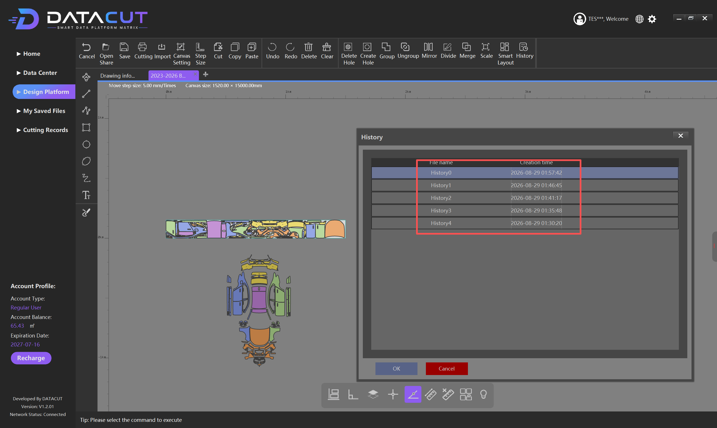
History
Function:View the operation history of the current design task
Auto-save:The system auto-saves every 5 minutes
Purpose:Understand the design process for easy operation management
Prevents:Data loss caused by improper operations or system failures

Slide 35
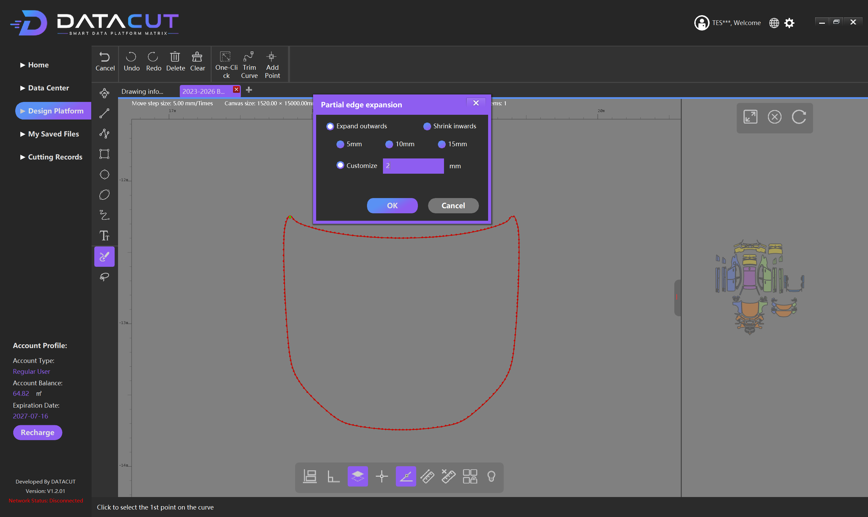
One-Click (one-click processing: expand/or shrink edges)
Function: select a segment of the film edge to expand outward or shrink inward, without changing the whole film shape.
1. Select the target film piece and double-click to enter edit mode so that edit points appear on the selected area;
2. Select all edit points, then choose the top One-Clickfunction button;
3. In the dialog, choose the operation steps: direction and expansion amount;
4. Expand outwards Expand outward (for parts that need wrapping or folded edges)
Shrink inwards Shrink inward (reduce the coverage area)
5mm / 10mm / 15mm Three quick expansion amount presets
Customize Custom value, unit mm
5. Click OK to apply.

Slide 36
Full-Process Operation Summary
The complete operation chain from software download to film cutting output
Step 1
Step 2
Step 3
Step 4
Step 5
Step 6
Download & Install
Register & Log In
Data Filtering
Template Design
Smart Layout
Cutting Output
Key Operation Points Review
• Filter vehicles in the order "Brand → Model → Year → Trim"
• 24 function buttons in the Design Platform, in six major categories
• After mirroring, check direction, dimensions, positioning holes, and outline
• For smart layout, set material length/width, spacing, and calculation time
• After layout, check there are no overlaps between parts (red warning)
• Save files regularly; the system auto-saves every 5 minutes
Master the above process and you can efficiently complete paint protection film design and cutting work
DATACUT Film Cutting System User Manual
Notes:
Finally, let's summarize the complete operation flow. The whole process has six steps: Step 1, download and install the software; Step 2, register and log in to the account; Step 3, filter vehicle data in the Data Center; Step 4, enter the Design Platform for film template design and editing; Step 5, use smart layout to optimize material utilization; Step 6, perform the cutting output. Key points include: always filter vehicles in the order of brand, model, year, and trim; the Design Platform has 24 function buttons in six major categories; after mirroring, carefully check the direction, dimensions, positioning holes, and outline; for smart layout, correctly set the material length/width, spacing, and calculation time; after layout, check that there are no overlaps between parts; save files regularly during operation — the system also auto-saves every 5 minutes. Once you master the above process, you can efficiently complete paint protection film design and cutting work.

